Slide 1

RAD204 Pathology
Endocrine Lecture 10
Dr Shai’
Week od December 22, 2013

Slide 2
Disorders of the Pituitary
Pituitary (hypophysis) is a small gland (~1000mg) on the sella turcica in the base of skull
Two parts:
  Anterior lobe: adenohypophysis, sunthesizes and secretes hormones which act on endocrine glands
  Posterior lobe: neurohypophysis, stores and secretes Antidiuretic Hormone and oxytocin (synthesized in hypothalamus)
  Secretion of pituitary hormones is regulated by neural & chemical stimuli from hypothalamus

Slide 3
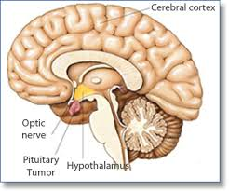
Pituitary anatomy

Slide 4
Anterior pituitary hyperpituitarism
Excess secretion of 1 or more pituitary hormones , usually from adenomas of anterior lobe
EFFECTS: endocrine & compressive effects from increase in local pressure
  Remainder of pituitary> hypopituitarism
  Optic chiasm> visual field defects, bitemporal hemianopia*
  Brain tumors distort midbrain architecture
  Dura> headache
  Cavernous sinus> CN III, IV, VI nerve palsies
INVESTIGATIONS
  Imaging: plain x ray, CT, MRI, cisternography* detects enlargement of sella turcica
  Hormone ASSAYS: eg growth hormone, prolactin
  Visual field assessment & functional pituitary – adrenal cortex axis test

Slide 5
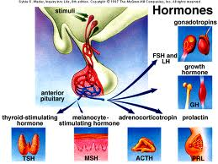

Slide 6
Anterior pituitary hypopituitarism
Insufficient secretion of pituitary hormones
Clinical features dependant on age, and severity
Aetilogy: hypothalmic or pituitary lesions
  Inflammation, Infarctions, deficiency of releasing factors, idiopathic deficiency of hormones, adenomas of anterioir pituitary, sheehan’s syndrome, empty sella syndrome, trauma, granulomatous lesions (tb, sarcoidosis)

Slide 7
Posterior pituitary
Diseases rarer
Usually result of hypothalmic damage from tumor or infarction
If damaged: affects ADH (anti diuretic hormone) secretion

Slide 8
Diabetes insipidus (DI)
Rare, persistent excretion of excess dilute urine and constant thirst
Types
  Cranial DI: caused by failure of ADH production
  Nephrogenic DI: distal tubules are refractory to water reabsroptive action of ADH
Clinical Features:
  Polyuria & risk of body water depletion
  Lethal without therapy
Investigations:
  Water deprivation test for 8 hours or until 3% body weight lost
    Demonstation of continued polyuria and haemoconcentration indicates DI
    This differentiates between psychogenic polydipsia nd DI
    TO DIFFERNTIATE BETWEEN CRANIAL DI (kidneys are responsive to ADH) and nephrogenic DI (kidneys unresponsive to ADH)

Slide 9
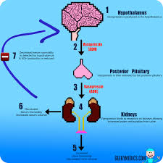
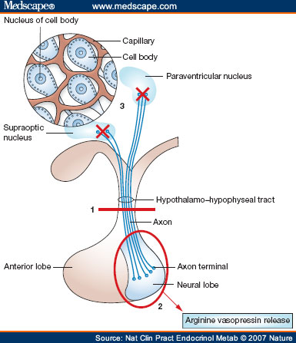

Slide 10
Thyrotoxicosis
Hyperthyroidism
Excess secretion of thyroid hormones (thyroxine, t4 and t3), in blood stream
Symptoms: tachycardia, sweating, tremor, anxiety, increased appetite, weight loss, intolerance to heat, goitre (enlargement of gland)
Aetiology
  Primary: increased thyroid hormones, low TSH
  Secondary: increased thryoid hormones from gland from excess TSH production from tumor in pituitary or elsewhere

Slide 11
hypothyroidism
Decreased activity of thyroid gland, results in decreased production of thyroid hormones
  1. Hypothyroidism at birth (CRETINISM)
  2. Acquired hypothyroidism in adulthood (MYXOEDEMA)

Slide 12
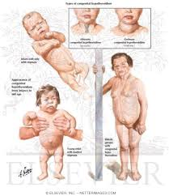
cretinism

Slide 13
cretinism
Congenital hypothyroidism
Aetiology:
  Endemic* occurs in iodine deficient countries, goitre common
  Sporadic from congenital hypoplasia of thyroid gland
  Dyshormonogenesis: familial recessive enzyme defect
Clinical features:
  Mental Retardation
  Retarded Growth, skeletal inhibition, short, stocky build
  Coarse, dry skin
  Lack of hair, teeth
  Pot belly
  Protruding tongue
Management: early detection (TSH heel prick test on day 4 of life)

Slide 14
Myxoedema, hypothyroidism adults
Common, decreased function of thyroid gland, decreased circulating thyroid hormone
Any age, common between 30 and 50 years)
MYXOEDEMA: non pitting, oedematous reaction from deposition of mucoid substance (myxo means mucus), in skin
Aetiology
  Autoimmune thyroiditis: atrophy of thyroid gland
  Grave’s Disease: after hyperthryoid thyrotoxicosis, 5% patients develop hypothryoidism, called Graves disease
  Treatment of hyperthyroidism: surgical ablastion, drug or radioiodine therapy
  Severe iodine deficiency from diet

Slide 15
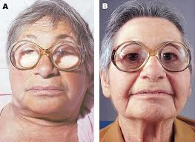
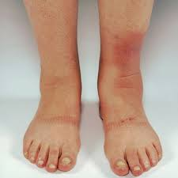
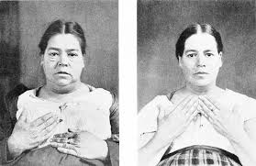
myxoedema

Slide 16
Effects of hypothyroidism
Mental and physical slowness
Tiredness
Cold intolerance
Dry skin and hair
Investigations: serum thyroxine and TSH levels

Slide 17
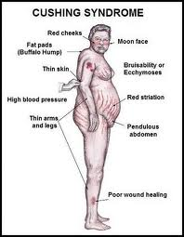
Adrenal gland disorders
Cushing’s Syndrome
  Prolonged inappropriate elevation of free corticosteroid levels
  Features
  * central obesity, moon face
  * plethora, acne
  * menstrual irregularity
  * hirsutism * and hair thining
  * Hypertension
  * Diabetes
  * Osteoporosis
  * Muscle wasting
  * Dermal atrophy

Slide 18
Cushings aetiopathogenesis
Pituitary hypersecretion of ACTH (Cushings disease) bilateral adrenal hyperplasia, secondary to excess secretion of ACTH by pituitary gland
Ectopic ACTH or CRH (corticotrophin releasing hormone) production by non endocrine neoplasm, eg oat cell carcinoma of bronchus *paraneoplastic
Iatrogenic steroid therapy *commonest cause of Cushings syndrome
Adrenal cortical adenoma: well-circumscribed yellow tumor, 2-5cm diameter, lipid filled
Adrenal cortical carcinoma: rare
INVESTIGATIONS:
  DEXAMETHASONE SUPPRESION TEST (suppress cortisol levels in Cushings due to suppression of pituitary ACTH secretion)
  MRI and CT to visualize pituitary and adrenal glands
  Blood: ACTH levels

Slide 19
Hypofunctioning adrenal cortex
Addison’s disease
Rare, chronic adrenal insufficiency due to lack of glucocorticoids and mineralcorticoids
Clinical features:
  Glucocorticoid insufficiency: vomiting, loss of appetite, weight loss, lethargy and weakness, postural hypotension, hypoglycaemia
  Mineralocortioid deficiency: low serum sodium, raised serum potassium, hypotension, dehydration
  Increased ACTH secretion: brown pigmentation in skin and buccal mucosa
  Loss of androgen: decreased body hair

Slide 20
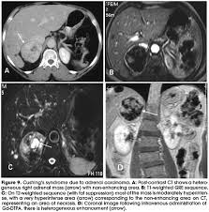
Adrenal medulla phaeochromocytoma
Rare tumor of adrenaline and non adrenaline secreting cells (chromaffin cells) of adrenal medulla

Slide 21
Pancreatic disorders
DIABETES MELLITUS (DM)
Multisystem disease of abnormal metabolic state, characterized by hyperglycaemia due to inadequate insulin action/production
  Primary: disorder of insulin production / action, 95% cases
  Secondary: 5%, from pancreatic disease (pancreatitis), cushings syndrome antagooizes insulin
Primary is further classified into
  Type I: insulin dependent DM, or juvenile onset
  Type II: NON insulin dependant or mature onset

Slide 22
Type I DM aetiology and pathogenesis
Organ specific, autoimmune induced disorder characterized by antibody mediated destructin of endocrine cell population of islet of Lnagerhans
2 factors predispose to autoimmunity
  Genetic predisposition, HLA DR3, DR4 positive
  Viral infection (measles, mumps, Coxsackie B)
  HISTOLOGICALLY
  * Pancreas shows lymphocyte infiltration and destruction of insulin secreting cells

Slide 23
Type II DM aetiology & pathogenesis
Involves:
  Genetic factors: familial tendancy in >95% cases
  Relative insulin deficiency: reduced secretion compared with amount required
  Insulin resistance: tissues unable to respond to insulin

Slide 24
Diagnosing Diabetes
Hyperglycaemia
Diagnostic Criteria
  Fasting venous blood glucose >7.8 mmol/L
  Random venous blood glucose >11.1 mmol/L on two occasions*

Slide 25
Complications of Diabetes Mellitus
ACUTE
  Hypoglycaemia (complication of overtreatment with insulin)
  Ketoacidosis: increased breakdown of triglycerides, icreased production of ketone bodies> impaired consciousness
  Hyperosmolarity: cerebral dehydration leading to coma
  Lactic acidosis: increased lactic acid as end product of glycolysis
  CHRONIC
  Vascular disease: atherosclerosis, diabetic microengiopathy
  Renal Disease: diabetic nephropathy
  Eye disease: diabetic retinopathy
  Predisposition to infections and abcess after foot trauma*
  Peripheral nerve damage: neuropathy, foot trauma

Slide 26
Zollinger Ellison Syndrome
Gastric hypersecretion, multiple peptic ulcers, diarrhoea, caused by gastrin secreting tumor (gastrinoma) of pancreatic G cells
Tumours are multiple in 50% cases, often malignant
May be part of MEN I syndrome, with adenomas in other endocrine glands

