Slide 2
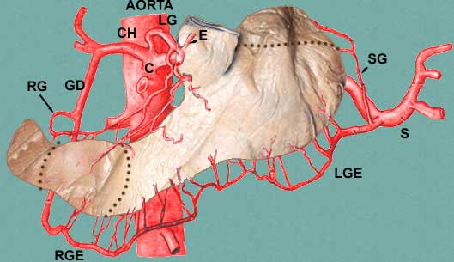
Notes:
ALL 3 classic branches of the celiac axis supply the stomach: Common hepatic, left gastric, and splenic

Slide 3
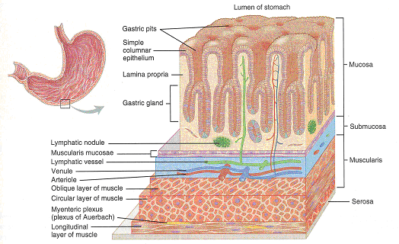
Notes:
If you think of the acid production in the stomach to be ONLY in the mid-BODY, and the proximal and distal ends as chiefly mucous to protect the esophagus and duodenum from the harsh acid, then you will understand the histology.

Slide 4
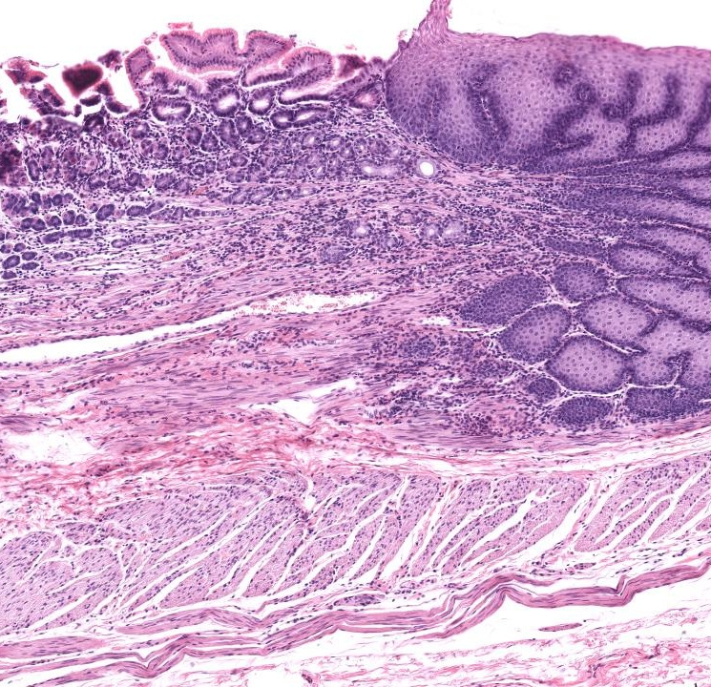
Notes:
GE Junction is a squamo-columnar junction. Do you see a distinct LGE “sphincter”? Answer: NO
Remember that BOTH the proximal and distal ends of the stomach NEUTRALIZE acid with alkaline MUCUS, rather than PRODUCE acid.

Slide 5
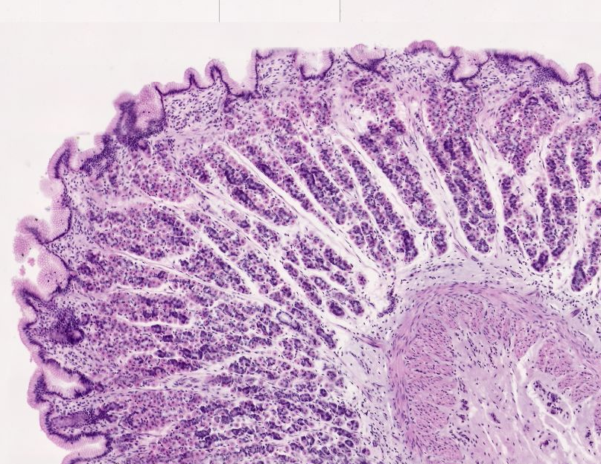
Notes:
Body with numerous chief and parietal (acid producing) cells.

Slide 6
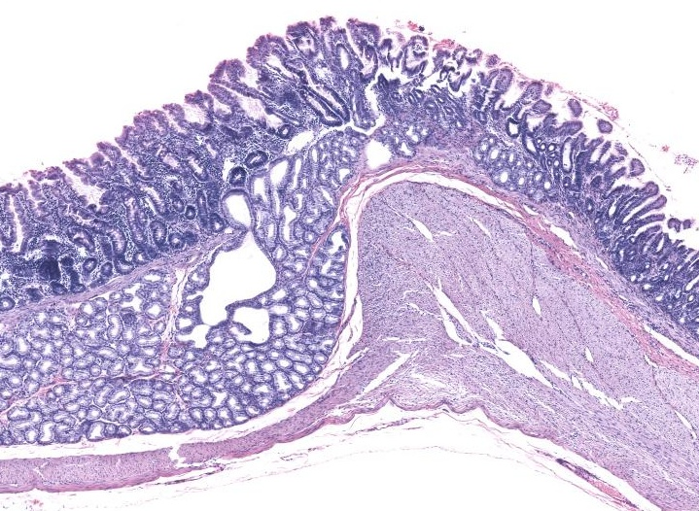
Notes:
Pyloric sphincter, note a few submucosal glands seen a little BEFORE the sphincter itself.

Slide 7
CELLS
MUCOUS: MUCUS, PEPSINOGEN II
CHIEF: PEPSINOGEN I, II
PARIETAL: ACID
ENTEROENDOCRINE: HISTAMINE, SOMATOSTATIN, ENDOTHELIN
Notes:
Somatostatin (also known as growth hormone-inhibiting hormone (GHIH) or somatotropin release-inhibiting factor (SRIF)) is a polypeptide that regulates the endocrine system and affects neurotransmission and cell proliferation via interaction with G-protein coupled somatostatin receptors and inhibition of the release of numerous secondary hormones.
Endothelins are proteins that constrict blood vessels and raise blood pressure.
Pepsinogens are PRECURSORS of protein hydrolyzing pepsins, having a few (~44) more polypeptides.

Slide 8
PHYSIOLOGY PHASES
(HCl Secretion)
CEPHALIC (VAGAL)‏
GASTRIC (STRETCH)‏
INTESTINAL (DUOD)‏
Notes:
• The cephalic phase, initiated by the sight, taste, smell, chewing, and swallowing of palatable food, is
mediated by vagal activity.
• The gastric phase involves stimulation of stretch receptors by gastric distention and is mediated by vagal impulses; it also involves gastrin release from endocrine cells, the G cells, in the antral glands. Gastrin release is promoted by luminal amino acids and peptides and possibly by vagal stimulation.
• The intestinal phase, initiated when food containing digested protein enters the proximal small intestine, involves a number of polypeptides besides gastrin.

Slide 9
ACID PROTECTION
MUCUS
HCO3-
EPITHELIAL BARRIERS
BLOOD FLOW
PROSTAGLANDIN E, I
Notes:
Prostaglandin E both DECREASES acid and INCREASES mucous.

Slide 10
CONGENITAL
ECTOPIC PANCREAS (ectopic pancreas tissue → stomach), very common
ECTOPIC GASTRIC (ectopic gastric tissue → pancreas), not rare
Diaphragmatic HERNIA→ Failure of diaphragm to close, not rare
PULMONARY SEQUESTER (rare) (foregut anomaly)
…..and the #1 congenital gastric disease→ ?????
Notes:
Remember the stomach develops, like the lungs, from the FOREGUT, if you want to understand developmental anomalies.

Slide 11
PYLORIC STENOSIS
CONGENITAL: (1/500), Neonatal obstruction symptoms, pyloric splitting curative
ACQUIRED: Secondary to extensive scarring such as advanced peptic ulcer disease
Notes:
What do you think the baby’s #1 symptom would have to be? Answer: VOMITING

