Slide 2
ADENOCARCINOMA
RISK FACTORS
H. pylori
H. pylori
H. Pylori
Nitrites, smoked meats, pickled, salted, chili peppers, socioeconomic, tobacco
Chronic gastritis, Barrett’s, adenomas
Family history

Slide 3
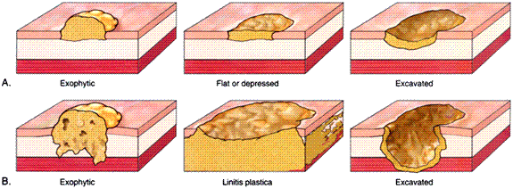
ADENOCARCINOMA
GROWTH PATTERNS
Notes:
These are logical anatomic or “geometric” descriptions, and NOT exact classifications.

Slide 4
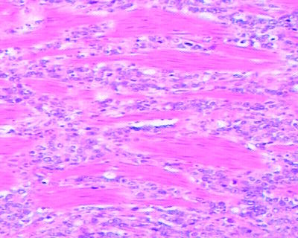
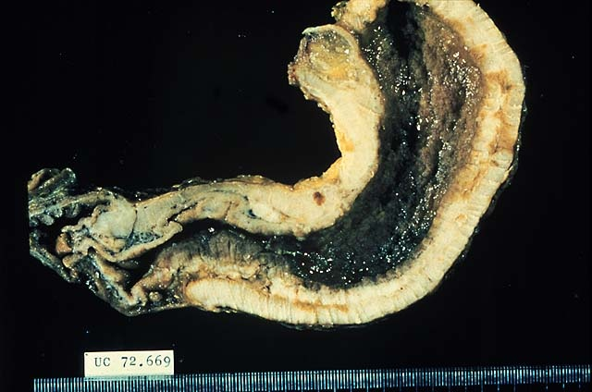

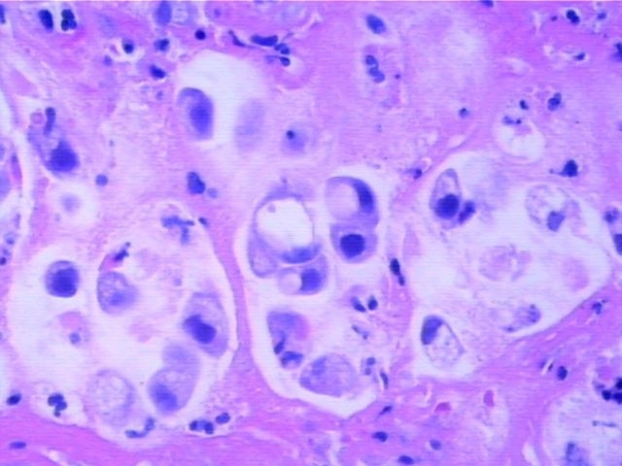
ADENOCARCINOMA
GROWTH PATTERNS
Notes:
The LINITIS PLASTICA is the most SPECTACULAR, and most FEARED, of all gastric adenocarcinomas. It grows DIFFUSELY through all layers of the stomach, greatly thickening its wall, and giving the stomach a classic LEATHER BOTTLE appearance. It has a horrible prognosis.
DIFFUSE WALL THICKENING of ALL FOUR STOMACH LAYERS IS THE RULE!!!!!!!
NOT ONLY DOES IT BEHAVE LIKE WILDFIRE BUT IS ALSO POORLY DIFFERENTIATED “SIGNET” CELLS, DIFFUSELY INFILTRATIVE.

Slide 5
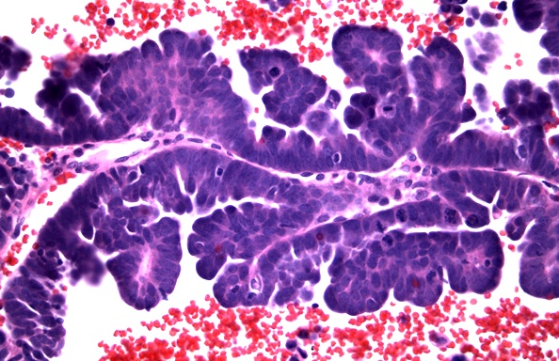
PAPILLARY
Notes:
Classical papilla! Malignant too.

Slide 6
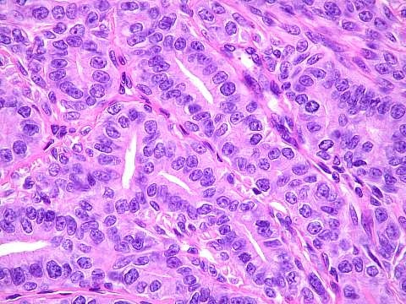
TUBULAR
Notes:
Of course, you would NEVER call this squamous.

Slide 7
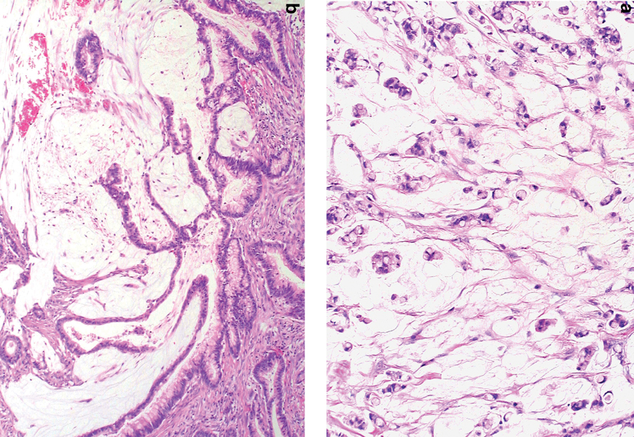
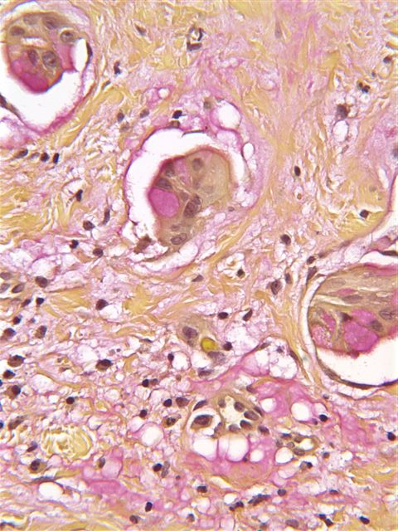
MUCINOUS
Notes:
If you thought this yucky whitish stuff was mucin, what stain would you order to prove it? Answer: Mucicarmine stain.
Is a positive muci-CARMINE stain RED (i.e., “carmine” colored)? Answer: YES

Slide 8
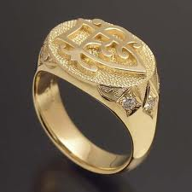
SIGNET RING
Notes:
Signet ring cells are POORLY differentiated adenocarcinoma cells, and are OFTEN seen with linitis plastica. Could those large “holes” in the cytoplasm possibly be mucicarmine positive” Answer: YES

Slide 9
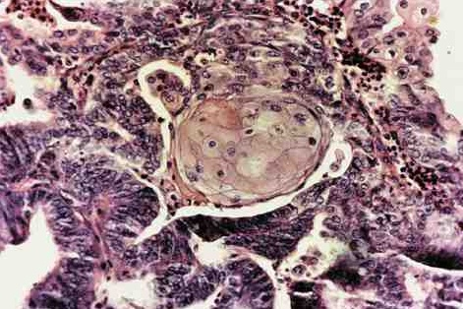
ADENOSQUAMOUS
Notes:
How can you have a squamous cell carcinoma of the stomach if the stomach has no normal squamous cells normally? Ans: SQUAMOUS METAPLASIA. The squamous component is usually NOT malignant

Slide 10
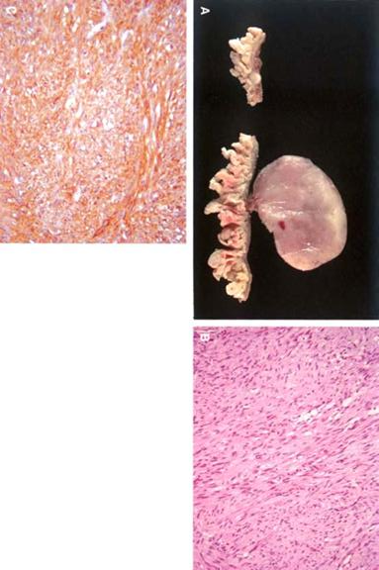
G.I.S.T. TUMORS
Can behave and/or look benign or malignant
Usually look like smooth muscle, i.e., “stroma”, “spindly”
Are usually POSITIVE for
c-KIT (CD117), i.e., express this antigen on immunochemical staining, the tumor cells are derived from the interstitial cells of Cajal, a “neural” type of cell, similar to the neural plexi found in the intestines.
Notes:
For as notoriously complex as all this sounds, they look like boring leiomyomas, and in the days PRE-immunochemistry, they probably WERE inaccurately called smooth muscle tumors, i.e., leiomyomas.

Slide 11
ENTEROENDOCRINE
SECRETORY PEPTIDES
Endocrine, Paracrine, Neurocrine
Chemical messengers
Regulate digestive functions
Serotonin, somatostatin, motilin, cholecystokinin, gastric inhibitory polypeptide, neurotensin, vasoactive inhibitory peptide (VIP), neuropeptides (generic), enteroglucagon
Notes:
Please review these hormones to understand their function:
Approximately 80 percent of the human body's total serotonin is located in the enterochromaffin cells in the gut, where it is used to regulate intestinal movements.
Somatostatin is classified as an inhibitory hormone to growth hormone, appropriately named, of course.
Motilin is secreted by endocrine M cells (these are not the same M cells that are in Peyer's patches) that are numerous in crypts of the small intestine. Motilin stimulates peristalsis.
Cholecystokinin a peptide hormone of responsible for stimulating the digestion of fat and protein and is synthesized by I-cells in the mucosal epithelium of the small intestine to stimulate the pancreas and gallbladder to release enzymes.
Gastric inhibitory polypeptide (GIP), also known as the glucose-dependent insulinotropic peptide is a member of the secretin family of hormones. It induces insulin secretion, and is primarily secreted by the duodenum..
Neurotensin is a 13 amino acid neuropeptide that is implicated in the regulation of LH and prolactin release and has significant interaction with the dopamine system.
VIP seems to induce GI smooth muscle relaxation.
Enteroglucagon is a peptide hormone secreted from mucosal cells primarily of the colon and terminal ileum. It has 37 amino acids. Enteroglucagon is released following ingestion of a mixed meal, and delays gastric emptying.

Slide 12
IMMUNE SYSTEM
MALT
PEYER PATCHES, mucosa, submucosa, 1˚, 2 ˚
IgGAMDE
Notes:
What is the difference between Peyer patches and MALT? Answer: Peyer patches are MALT of the Ileum. Originally they were described in the distal ileum.

Slide 13
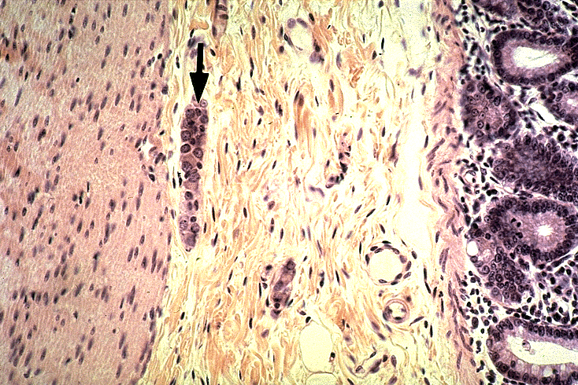
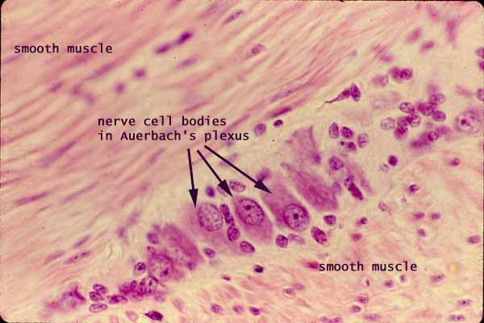
NEUROMUSCULAR
AUTONOMIC (VAGUS, Symp.)-----extrinsic
INTRINSIC (gut has it’s own brain)
  Meissner (submucosa)
  Auerbach (between circular and longitudinal)

Slide 14
CONGENITAL
DUPLICATION
MALROTATION
OMPHALOCELE
GASTROSCHISIS
ATRESIA/STENOSIS SPECTRUM
MECKEL (terminal ileum, “vitelline” duct)
AGANGLIONIC MEGACOLON (HIRSCHSPRUNG DISEASE)
Notes:
Gastroschisis is also called paraomphalocele, laparoschisis, or abdominoschisis. Gastroschisis is a birth defect in which an infant's intestines stick out of the body through a defect on one side of the umbilical cord.
Similarly, omphalocoele is a type of abdominal wall defect in which the intestines, liver, and occasionally other organs remain outside of the abdomen in a sac because of a defect in the development of the muscles of the abdominal wall.

Slide 15
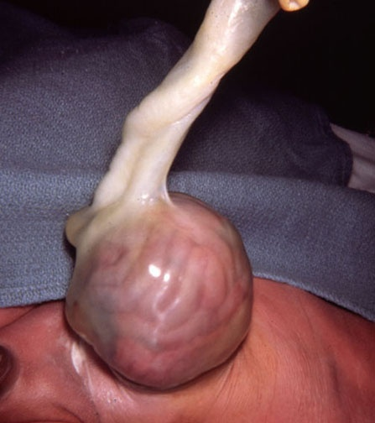
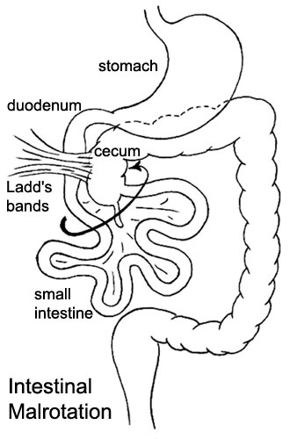
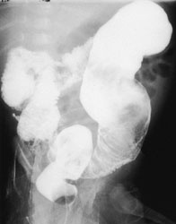
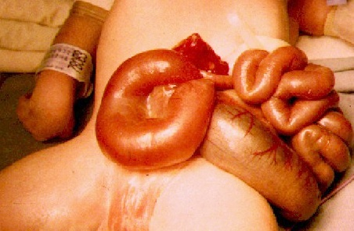
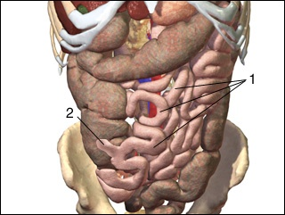
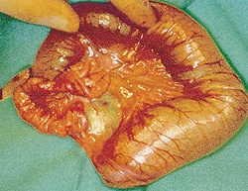
Notes:
Can you understand that these appearances represent just about all of the “congenital” bowel diseases?
Answer: Yes. Can you name the disease with the arrow and progress counterclockwise?
Gastrochisis→Omphalocele→Atresia/stenosis→Meckel diverticulum→Hirschsprung→Malrotation

Slide 16
ENTEROCOLITIS
DEFINITION of diarrhea: INCREASE in MASS, FLUIDITY, and/or FREQUENCY
DIARRHEA is merely a SYMPTOM: 1) SECRETORY, 2) OSMOTIC, 3) EXUDATIVE, 4) MALABSORPTION, 5) MOTILITY
  INFECTIOUS (Viral, Bacterial, Parasitic)
  NECROTIZING
  COLLAGENOUS
  LYMPHOCYTIC
  AIDS
  After BMT
  DRUG INDUCED
  RADIATION
  “SOLITARY” RECTAL ULCER
Notes:
Understand the 5 different types of diarrhea, and the relationship between enterocolitis (inflammatory disease) and diarrhea (symptom)

Slide 17
SECRETORY DIARRHEA
Viral damage to mucosal epithelium
Entero-toxins, bacterial
Tumors secreting GI hormones
Excessive laxatives
Notes:
If the purpose of a bowel mucosal epithelial cell is to absorb fluid, it does NOT absorb fluid when it is damaged.

