Slide 1
BACTERIAL enterocolitis
Ingestion of bacterial toxins
  Staph
  Vibrio
  Clostridium
Ingestion of bacteria which produce toxins
  Montezuma’s revenge (traveller’s diarrhea), E.coli
Infection by enteroinvasive bacteria
  Enteroinvasive E. coli (EIEC)
  Shigella
  Clostridium difficile
Notes:
“Traveller’s diarrhea” usually refers to E. coli infections, but also has a more generic connotation.
Which of these 3 conditions is most likely to produce histopathologic mucosal changes and blood in stools?? Ans: Enteroinvasive bacteria

Slide 2
E. coli
Toxin, invasion, many subtypes
Food, water, person-to-person
Usually watery, some hemorrhagic
INFANTS often, in epidemics
Notes:
What type of E. coli would be most likely to produce “hemorrhagic” diarrhea? Ans:Entero-invasive

Slide 3
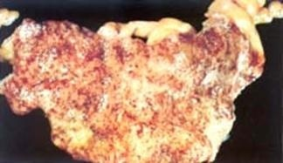
SALMONELLA
Food, not hemorrhagic
SHIGELLA
(person-to-person, invasive, i.e., often hemorrhagic)

Slide 4
CAMPLYOBACTER
^{Toxins, Invasion}
^{Food spread}

Slide 5
YERSINIA (enterocolitica)
Food
Invasion
LYMPHOID REACTION
Notes:
Can a yersinia infection look like a maltoma? Ans: YES

Slide 6
VIBRIO cholerae
Water, fish, person-to-person
Cholera epidemics
NO invasion (watery)
ENTEROTOXIN

Slide 7
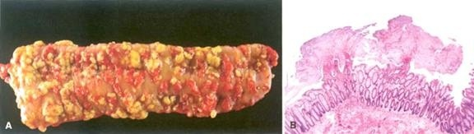
CLOSTRIDIUM DIFFICILE
CYTOTOXIN (lab test readily available)
NOSOCOMIAL
PSEUDOMEMBRANOUS (ANTIBIOTIC ASSOCIATED) COLITIS
Notes:
Pseudomembranous colitis is usually also called “antibiotic induced” colitis. Why? (figure out this one yourself)

Slide 8
MALABSORPTION
INTRALUMINAL
BRUSH BORDER (microvilli)
(TRANS)EPITHELIAL
OTHER
  REDUCED MUCOSAL AREA: Celiac, Crohns
  LYMPHATIC OBSTRUCTION: Lymphoma, TB
  INFECTION
  IATROGENIC: Surgical
Notes:
Like Diarrhea, malabsorption is a SYMPTOM, not a disease. As you can see it can be intricately related to diarrhea.
Malabsorption is a very LOGICAL concept.

Slide 9
INTRALUMINAL
PANCREATIC
DEFECTIVE/REDUCED BILE
BACTERIAL OVERGROWTH

Slide 10
BRUSH BORDER
DISACCHARIDASE DEFICIENCY
BRUSH BORDER DAMAGE, e.g., by bacteria

Slide 11
(Trans)EPITHELIAL
ABETALIPOPROTEINEMIA
BILE ACID TRANSPORTATION DEFECTS

Slide 12
CELIAC DISEASE
Also called SPRUE
Also called NON-tropical SPRUE
Also called GLUTEN-SENSITIVE ENTEROPATHY
  Sensitivity to GLUTEN, a wheat protein, gliadin
  Immobilizes T-cells
  Also in oat, barley, rye
  Progressive mucosal “atrophy”, i.e. villous flattening
  Relieved by gluten withdrawal
Notes:
Have you noted the trend for your favorite restaurant to offer gluten-free dishes, like pizza?

Slide 13
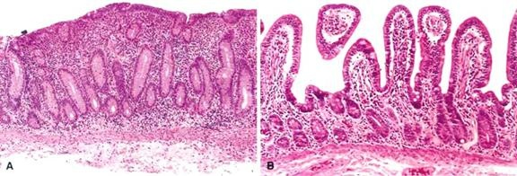
CELIAC DISEASE
Notes:
Mucosal (villous) flattening and chronic mucosal inflammation, Which one is more advanced? LEFT or RIGHT? Ans: The FLATTER one

Slide 14
“TROPICAL” SPRUE
Epidemic forms
NOT related to gluten, cause UN-known
RECOVERY with antibiotics

Slide 15
WHIPPLE’s DISEASE
DISTENDED MACROPHAGES in the LAMINA PROPRIA
PAS positive
ROD SHAPED BACILLI

Slide 16
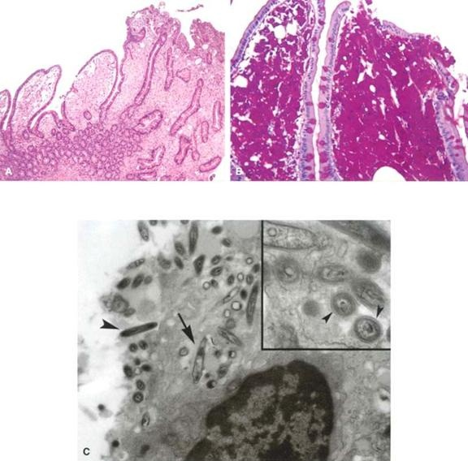
WHIPPLE’s DISEASE
Notes:
Whipple's disease is a rare, systemic infectious disease caused by the bacterium Tropheryma whipplei

Slide 17
DISACCHARIDASE DEFICIENCY
LACTASE by far MOST COMMON
ACQUIRED, NOT CONGENITAL
LACTOSE→ GLUCOSE + GALACTOSE
LACTOSE (fermented)→XXXXXXXXX
OSMOTIC DIARRHEA
Notes:
This is a classic examlpe of the malabsorption/diarrhea intimate relationship.

Slide 18
ABETALIPOPROTEINEMIA
Autosomal recessive
Rare
Inability to make chylomicrons from FFAs and MONOGLYCERIDES
Infant failure to thrive, diarrhea, steatorrhea

Slide 19
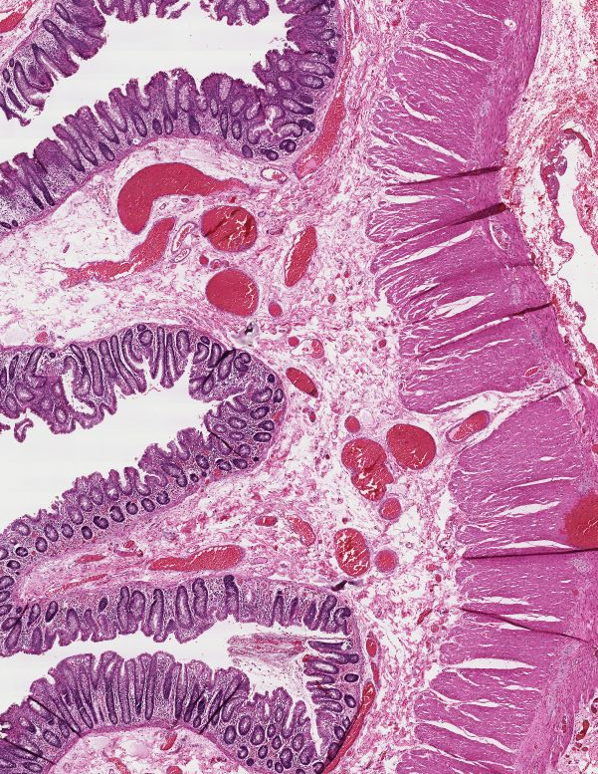
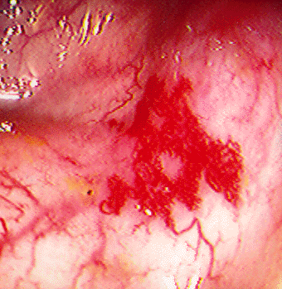
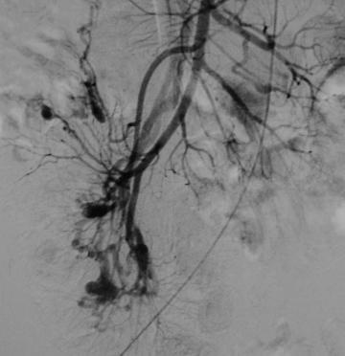
ANGIODYSPLASIA
NOT really “dysplasia”
NOT neoplastic
TWISTED, DILATED SUBMUCOSAL VESSELS, can rupture!
Common X-ray finding
Notes:
Think of it as an AVM of the colonic submucosa!
A VERY common cause of GI bleeding.

