Slide 1
Lec 9.1.3

Slide 2
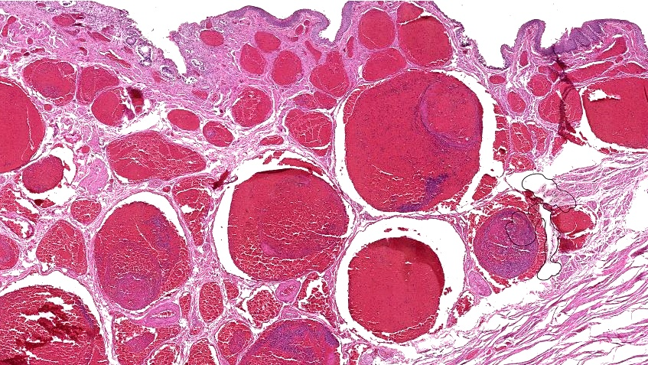
HEMORRHOIDS
INCREASED INTRABDOMINAL PRESSURE
i.e., VALSALVA
INTERNAL vs. EXTERNAL
Notes:
Like varices, the ultimate cause is chronically elevated increased submucosal venous pressure, either from portal hypertension (much less likely), or ANYTHING which commonly causes chronically increased abdominal pressure, i.e., the same forces which are associated with abdominal hernias.

Slide 3
DIVERTICULOSIS/-ITIS
FULL THICKNESS BOWEL OUTPOCKETING
Assoc. w.:
  INCREASED LUMINAL PRESSURE, ↑transit time
  AGE
  L→R (decreased liquidity)
  Decreased dietary FIBER
  Weakening of wall

Slide 4
DIVERTICULOSIS/-IT IS
(CLINICAL)
IMPACTION
INFLAMMATION (“appendicitis” syndrome)
PERFORATION→ Peritonitis, local, diffuse
BLEED, silently, even fatally
OBSTRUCT
EXTREMELY EXTREMELY COMMON
NOT assoc. w. neoplasm, but mimic carcinomas clinically, radiologically, surgically, and grossly!

Slide 5
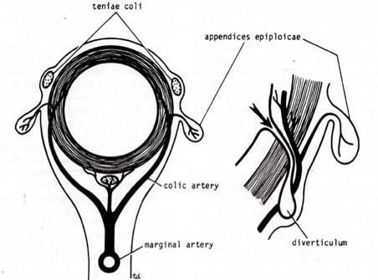
Formation of colonic diverticuli
The most commonly known colonic diverticuli are pseudo diverticuli – composed of only mucosa on the luminal side and serosa externally. Why are these called “pseudo” or false?
Diverticuli resemble hernias of the colonic wall in that they occur @ sites of entry of mucosal arteries as they pass through the muscularis – this represents a weak spot that leads to a diverticulum if the individual generates high colonic intraluminal pressure (low fiber diet)
Notes:
5
Like the esophagus “pseudo” means LACK of all 4 classical layers.
The perforating branches of the mesenteric artery branches are the weak links to be a setting for diverticuli!

Slide 6
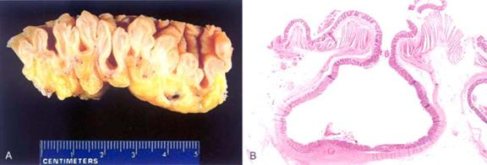
DIVERTICULOSIS

Slide 7
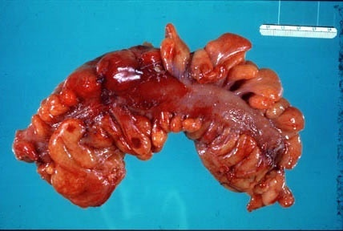
DIVERTICULITIS

Slide 8
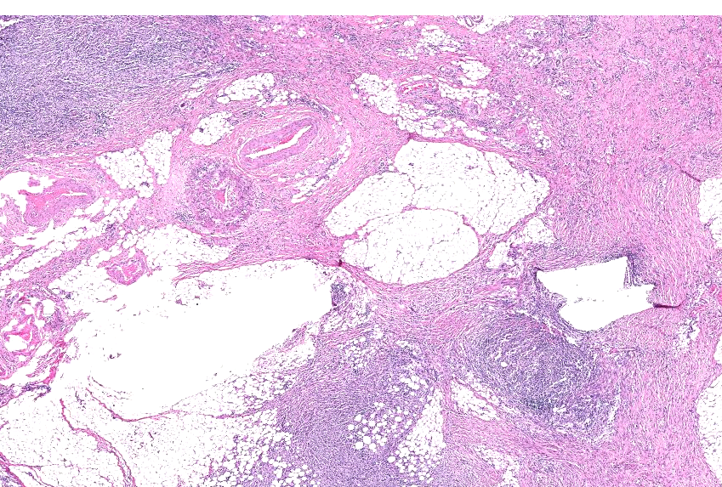
DIVERTICULITIS
Notes:
When diverticuli are inflamed, you may not see a mucosa very easily.

Slide 9
OBSTRUCTION
ANATOMY
  ADHESIONS (post-surgical)
  IMPACTION
  HERNIAS
  VOLVULUS
  INTUSSUSCEPTION
  TUMORS
  INFLAMMATION, such as IBD (Crohn) or divertics
  STRICTURES/ATRESIAS
  STONES, FECALITHS, FOREIGN BODIES
  CONGENITAL BANDS, MECOMIUM, INPERF. ANUS

