Slide 2
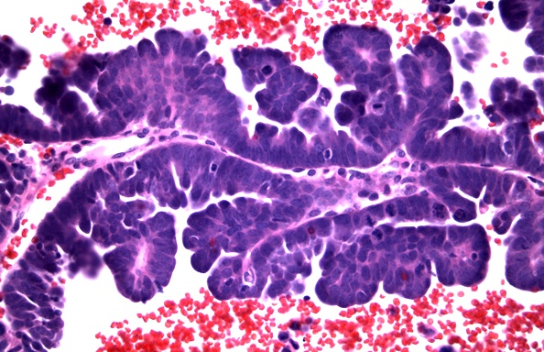
PAPILLARY
Notes:
Does this look familiar? Like you’ve seen it before? Like stomach adenocarcinomas?

Slide 3
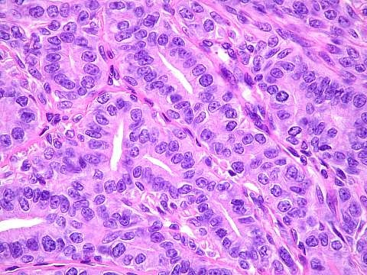
TUBULAR
Notes:
Does this look familiar? Like you’ve seen it before? Like stomach adenocarcinomas?

Slide 4
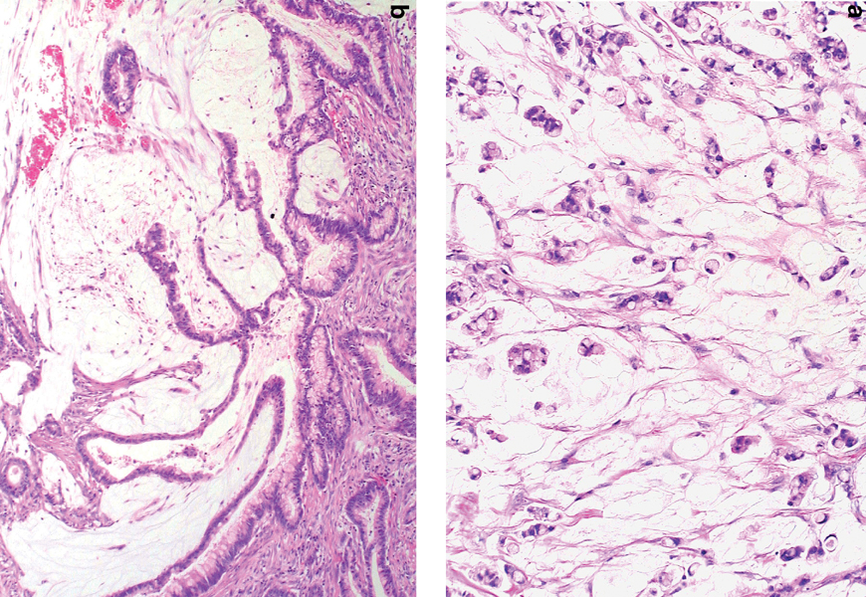
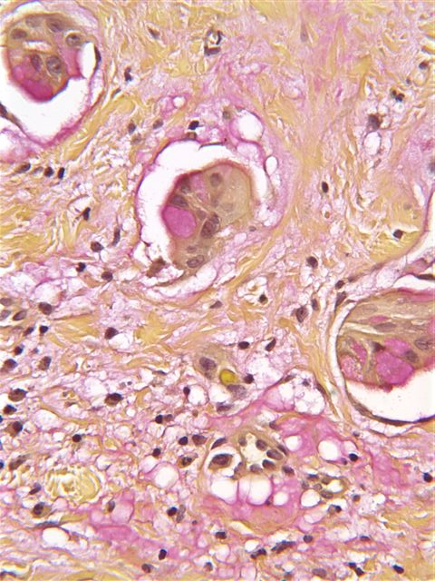
MUCINOUS
Notes:
Does this look familiar? Like you’ve seen it before? Like stomach adenocarcinomas?

Slide 5
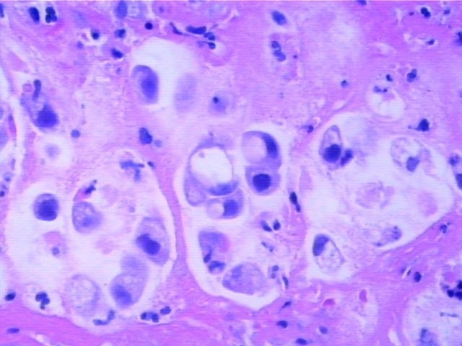
SIGNET RING
Notes:
Signet ring cells are POORLY differentiated adenocarcinoma cells, and are OFTEN seen with linitis plastica.
Does this look familiar? Like you’ve seen it before? Like stomach adenocarcinomas?

Slide 6
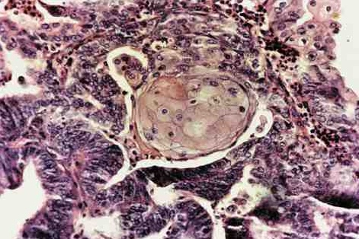
ADENOSQUAMOUS
Notes:
Does this look familiar? Like you’ve seen it before? Like stomach adenocarcinomas?

Slide 7
Tumor Stage | Histologic Features of the Neoplasm
Tis | Carcinoma in situ (high-grade dysplasia) or intramucosal carcinoma (lamina propria invasion)
T1 | Tumor breaches the musc. muc. invades into submucosa
T2 | Extending into the muscularis propria but not penetrating through it
T3 | Penetrating through the muscularis propria into subserosa
T4 | Tumor directly invades other organs or structures
Nx | Regional lymph nodes cannot be assessed
N0 | No regional lymph node metastasis
N1 | Metastasis in 1 to 3 lymph nodes
N2 | Metastasis in 4 or more lymph nodes
Mx | Distant metastasis cannot be assessed
M0 | No distant metastasis
M1 | Distant metastasis
Notes:
To me, this looks very logical.
Often the DUKES classification may be used?

Slide 8
OTHER TUMORS
CARCINOID, with or without syndrome
LYMPHOMA (MALTOMAS, B-Cell)
LEIOMYOMA/-SARCOMA
LIPOMA/-SARCOMA

Slide 9
ANAL CANAL CARCINOMAS
MORE LIKELY TO BE SQUAMOUS, or “basaloid”
WORSE IN PROGNOSIS
HPV RELATED

