Slide 1
Lec 9 rad240 pathology
G I T Pathology
continuation

Slide 2
OSMOTIC DIARRHEA
Disaccharidase deficiencies
Bowel preps
Antacids, e.g., MgSO4
Notes:
An “osmotic” diarrhea means there are too many solutes in the lumen and therefore absorption is impaired, it is LEAST LIKELY to be associated with anatomic bowel mucosa damage.

Slide 3
EXUDATIVE DIARRHEA
BACTERIAL DAMAGE to GI MUCOSA
IBD
TYPHLITIS (immunosuppression colitis)
Notes:
Increased damage to an intestinal mucosal epithelial cell can result in EXUDATE from the mucosa TO the lumen. The condition is usually caused by gram positive enteric commensal bacteria of the gut (gut flora). Caecitis affects immunocompromised patients, such as those undergoing chemotherapy, patients with AIDS, kidney transplant patients, or the elderly

Slide 4
MALABSORPTION DIARRHEA
INTRALUMINAL
MUCOSAL CELL SURFACE
MUCOSAL CELL FUNCTION
LYMPHATIC OBSTRUCTION
REDUCED FUNCTIONING BOWEL SURFACE AREA
Notes:
Malabsorption can be at the pancreas, bile, or bowel mucosal level.

Slide 5
MOTILITY DIARRHEA
DECREASED TRANSIT TIME
  Reduced gut length
  Neural, hyperthyroid, diabetic
  Carcinoid syndrome
INCREASED TRANSIT TIME
  Diverticula
  Blind loops
  Bacterial overgrowth
Notes:
Understand how BOTH a DECREASED or INCREASED transit time can be associated with diarrhea.

Slide 6
INFECTIOUS enterocolitis
VIRAL
  Rotavirus (69%), Calciviruses, Norwalk-like, Sapporo-like, Enteric adenoviruses, Astroviruses
BACTERIAL
  E. coli, Salmonella, Shigella, Campylobacter, Yersinia, Vibrio, Clostridium difficile, Clostridium perfringens, TB
  Bacterial “overgrowth”
PARASITIC
  Ascaris, Strongyloides, Necator, Enterobius, Tricuris
  Diphyllobothrium, Taenia, Hymenolepsis
  Amebiasis (Entamoeba histolytica)
  Giardia
Notes:
Rotavirus is the most likely cause of “stomach” flu, especially in kids.

Slide 7
VIRAL enterocolitis
Rotavirus most common, by far
  Selectively infects and destroys mature enterocytes in the small intestine
  Crypts spared
Most have a 3-5 day course
Person to person, food, water
Notes:
Enterocytes are the most common type of intestinal cell and they ABSORB water and nutrients, so it is no surprise that watery diarrhea and malabsorption can be the sequelae when there is a disease of enterocytes.

Slide 8
BACTERIAL enterocolitis
Ingestion of bacterial toxins
  Staph
  Vibrio
  Clostridium
Ingestion of bacteria which produce toxins
  Montezuma’s revenge (traveller’s diarrhea), E.coli
Infection by enteroinvasive bacteria
  Enteroinvasive E. coli (EIEC)
  Shigella
  Clostridium difficile
Notes:
“Traveller’s diarrhea” usually refers to E. coli infections, but also has a more generic connotation.
Which of these 3 conditions is most likely to produce histopathologic mucosal changes and blood in stools?? Ans: Enteroinvasive bacteria

Slide 9
E. coli
Toxin, invasion, many subtypes
Food, water, person-to-person
Usually watery, some hemorrhagic
INFANTS often, in epidemics
Notes:
What type of E. coli would be most likely to produce “hemorrhagic” diarrhea? Ans:Entero-invasive

Slide 10
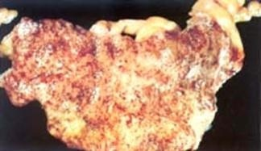
SALMONELLA
Food, not hemorrhagic
SHIGELLA
(person-to-person, invasive, i.e., often hemorrhagic)

Slide 11
CAMPLYOBACTER
^{Toxins, Invasion}
^{Food spread}

Slide 12
YERSINIA (enterocolitica)
Food
Invasion
LYMPHOID REACTION
Notes:
Can a yersinia infection look like a maltoma? Ans: YES

Slide 13
VIBRIO cholerae
Water, fish, person-to-person
Cholera epidemics
NO invasion (watery)
ENTEROTOXIN

Slide 14
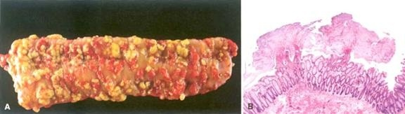
CLOSTRIDIUM DIFFICILE
CYTOTOXIN (lab test readily available)
NOSOCOMIAL
PSEUDOMEMBRANOUS (ANTIBIOTIC ASSOCIATED) COLITIS
Notes:
Pseudomembranous colitis is usually also called “antibiotic induced” colitis. Why? (figure out this one yourself)

Slide 15
BACTERIAL OVERGROWTH SYNDROME
One of the main reasons why “normal” gut flora is NOT usually pathogenic, is because, they are constantly cleared by a NORMAL transit time.
BLIND LOOPS
DIVERTICULA
OBSTRUCTION
Bowel PARALYSIS
Notes:
Bacterial overgrowth syndromes result in, and are caused by, L---O---N---G transit times

Slide 16
PARASITES
NEMATODES (ROUNDWORMS)
  Ascaris, Strongyloides, Hookworms (Necator & Anklyostoma), Enterobius, Trichuris
CESTODES (TAPEWORMS)
  FISH (DIPHYLLOBOTHRIUM latum)
  PORK (TAENIA solium)
  DWARF (HYMENOLEPSIS nana)
PROTOZOANS: AMOEBA (ENTAMOEBA histolytica), Giardia lamblia
Notes:
Helminths generally do not produce too much mucosal damage, BECAUSE “a successful parasite never kills its host”. This principle is also true in the business world and the usury trade. If you remember, the loan sharks rarely killed their victims, they just threatened to. Just like banks and credit card companies too.

Slide 17
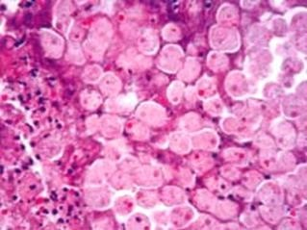
ENTAMOEBA HISTOLYTICA

Slide 18
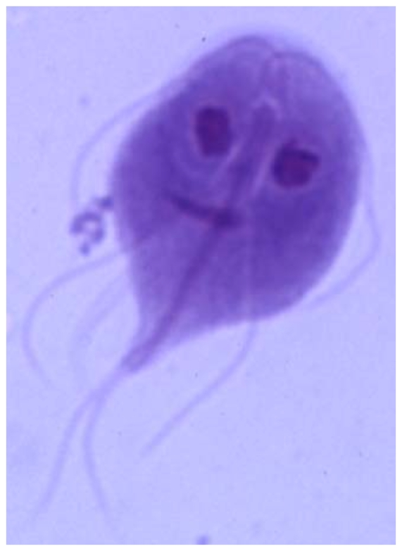
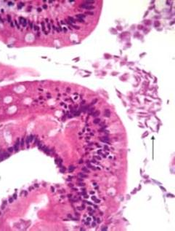
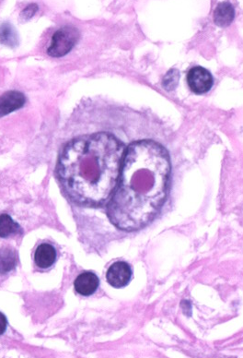
GIARDIA LAMBLIA
Notes:
Giardiasis in humans is caused by the infection of the small intestine by the CYST of a single-celled organism called Giardia lamblia. Giardiasis occurs worldwide with a prevalence of 20–30%^{[1]} in developing countries. Additionally, Giardia has a wide range of human and other mammalian hosts, thus making it very difficult to eliminate. The CDC reports that in the US Giardia infects over 2.5 million people annually. This is one of the main reasons why people tell you “please do not drink the water”. PS: THE CYSTS CAN LIVE IN ICE TOO, SUCH AS SNO-CONES.
Like the Reed-Sternberg cell, this flagellate often gives you the feeling it is looking back at you when you look at it under the diagnostic microscope.

Slide 19
MISC. COLITIS (OTHER)
NECROTIZING ENTEROCOLITIS (neonate) (Cause unclear)
COLLAGENOUS (Cause unclear)
LYMPHOCYTIC (Cause unclear)
AIDS
GVHD after BMT, as in stomach
DRUGS (NSAIDS, etc., etc., etc.)
RADIATION, CHEMO
NEUTROPENIC (TYPHLITIS), (cecal, caecitis)
“DIVERSION” (like overgrowth)
“SOLITARY” RECTAL ULCER (anterior, motor dysfunction)

