Slide 2
(I) IBD
CROHN DISEASE (granulomatous colitis)
ULCERATIVE COLITIS
Notes:
Idiopathic Inflammatory Bowel Disease

Slide 3
(I) IBD
COMMON FEATURES
  IDIOPATHIC
  DEVELOPED COUNTRIES
  COLONIC INFLAMMATION
  SIMILAR Rx
  BOTH have increased CANCER RISK
Notes:
Idiopathic Inflammatory Bowel Disease.
WHY increased cancer risk? Initiation or Promotion?

Slide 4
(I) IBD DIFFERENCES
CROHN (CD)
  TRANSMURAL, THICK WALL
  NOT LIMITED to COLON
  GRANULOMAS
  FISTULAE COMMON
  TERMINAL ILEUM OFTEN
  SKIP AREAS
  “CRYPT” ABSCESSES NOT COMMON
  NO PSEUDOPOLYPS
  MALABSORPTION
ULCERATIVE (UC)
  MUCOSAL, THICK MUCOSA
  LIMITED to COLON
  NO GRANULOMAS
  FISTULAE RARE
  TERMINAL ILEUM NEVER
  NO SKIP AREAS
  “CRYPT” ABSCESSES COMMON
  PSEUDOPOLYPS
  NO MALABSORPTION
Notes:
Idiopathic Inflammatory Bowel Disease

Slide 5
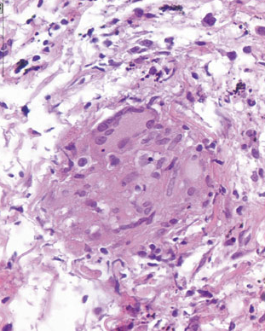
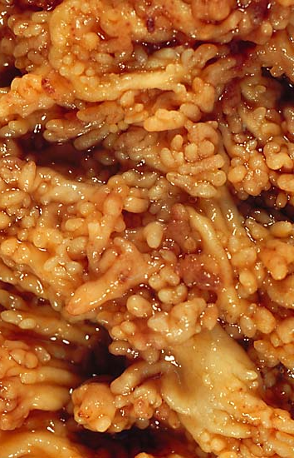
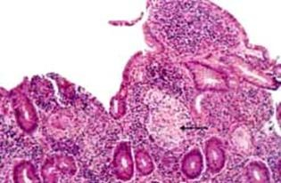
CROHN vs. UC
Notes:
Granulomas are NOT found in UC, distinct mucosal pseudopolyps are not found in CD

Slide 6
VASCULAR DISEASES
ISCHEMIA/INFARCTION
ANGIO-”DYSPLASIA”*
HEMORRHOIDS
Notes:
* NOT “dysplastic” in the classic sense of the word

Slide 7
ISCHEMIA/INFARCTION
HEMORRHAGE is the main HALLMARK of ischemic bowel disease
  ARTERIAL THROMBUS
  ARTERIAL EMBOLISM
  VENOUS THROMBUS
  CHF, SHOCK
  INFILTRATIVE, MECHANICAL
MUCOSAL→ TRANSMURAL

Slide 8
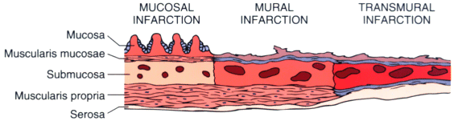
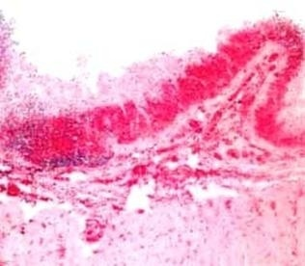
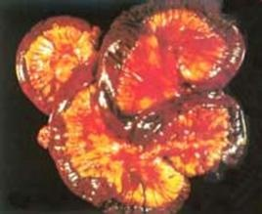
Notes:
Transmurally infarcted bowel is usually purple and paper thin.

Slide 9
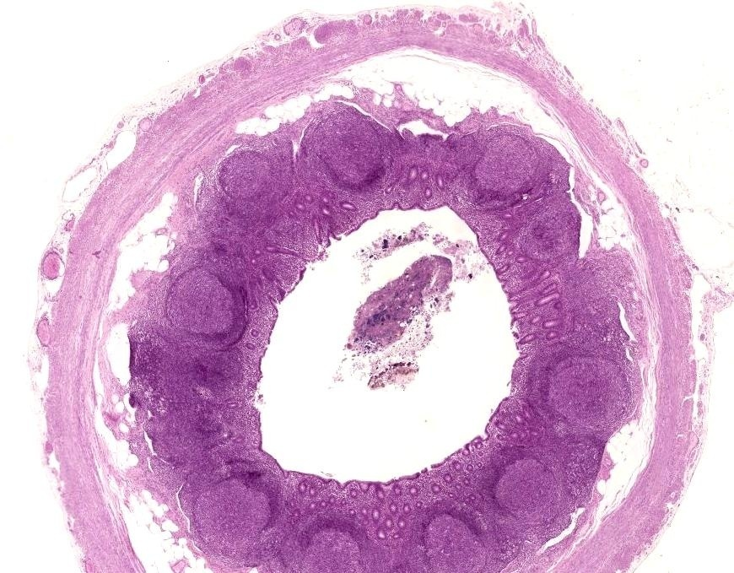
A
P
P
E
N
D
I
X

Slide 10
ANATOMY
Junction of 3 tenia coli, variable in location
All 4 layers, true serosa
Thickest layer is submucosal lymphoid tissue
APPENDICITIS (ACUTE)
MUCOCELE
MUCUS CYSTADENOMA
MUCUS CYSTADENOCARCINOMA

Slide 11
ACUTE APPENDICITIS
GENERALLY, a disease of YOUNGER people
OBSTRUCTION by FECALITH the classic cause but fecaliths present only about half the time
EARLY APPENDICITIS: NEUTROPHILS→Mucosa, submucosa
NEED NEUTROPHILS in the MUSCULARIS to confirm the DIAGNOSIS
25% normal rate, usually
Perforation→peritonitis the rule, if no surgery
Notes:
Why do you need neutrophils in the muscularis?
Ans: to differentiate from a peritoneal inflammation or luminal pus from another part of the bowel.

Slide 12
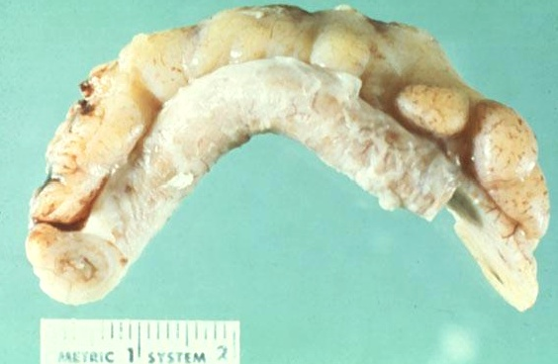
ACUTE APPENDICITIS
Notes:
What is the white junk coating the surface? Answer: FIBRIN

Slide 13
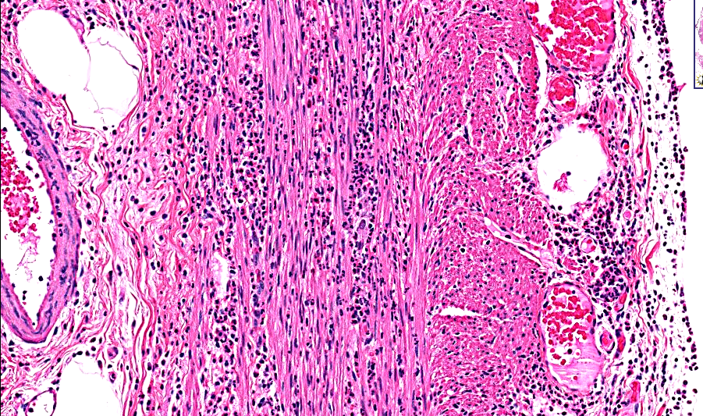
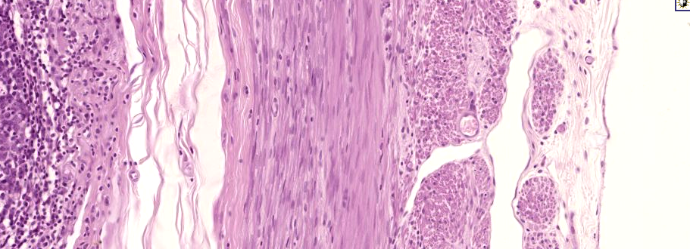
Notes:
The presence of neutrophils invading the muscularis is the diagnostic criteria needed to diagnosis or confirm, acute appendicitis!

Slide 14
Mucus “TUMORS”
Mucocele (common)
Mucinous Cystadenoma (rather rare)
Mucinous Cystadenocarcinoma (rare)

Slide 15
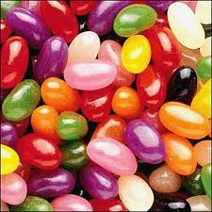
MUCOCELE
COMMON CYST on APPENDIX filled with MUCIN
Can RUPTURE to become:
  PSEUDOMYXOMA PERITONEII
  (Jelly Belly)

