Slide 1
Lecture 9.3 rad240 pathology
Dr shai’

Slide 2
POLYPS
ANY mucosal bulging, blebbing, or bump
HYPERPLASTIC (NON-NEOPLASTIC)
HAMARTOMATOUS (NON-NEOPLASTIC)
ADENOMATOUS (TRUE NEOPLASM, and regarded by many as “potentially” PRE-MALIGNANT as well)
SESSILE vs. PEDUNCULATED
TUBULAR vs. VILLOUS

Slide 3
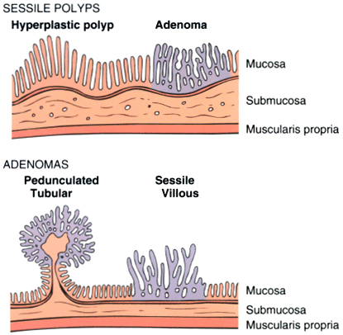
POLYPS

Slide 4
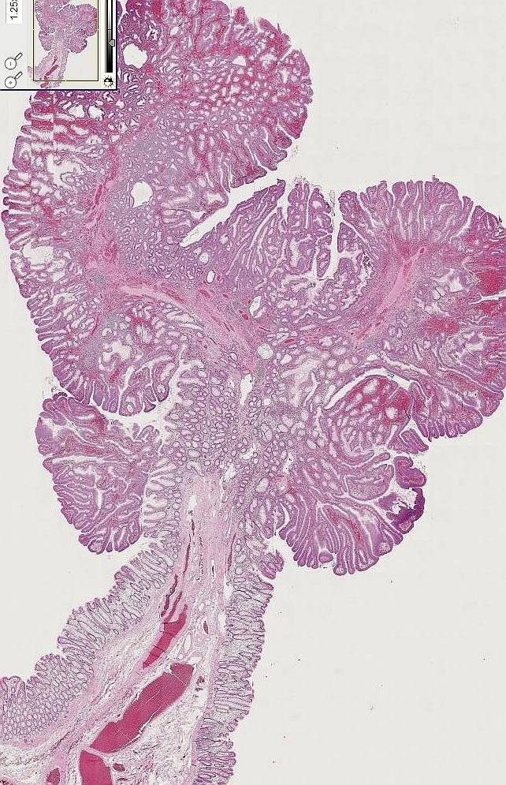
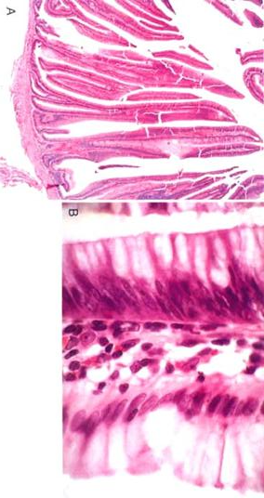
PEDUNCULATED vs VILLOUS vs SESSILE
Notes:
A villous pattern of growth, BY GEOMETRY ALONE, implies a faster growth rate than a tubular pattern of growth, hence a greater risk of malignant transformation.

Slide 5
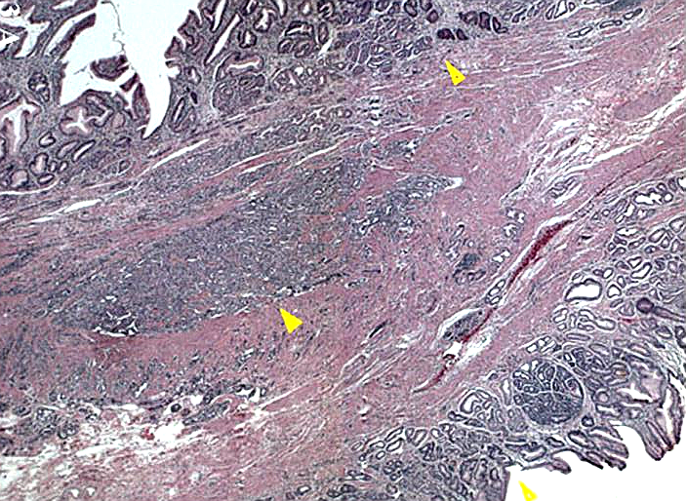
BENIGN vs. MALIGNANT
Usual, atypia, pleo-, hyper-, mitoses, etc.
Stalk invasion!!!
Notes:
What is more important?
How yucky the nuclei look?
If the glands have invaded into the submucosal stalk?

Slide 6
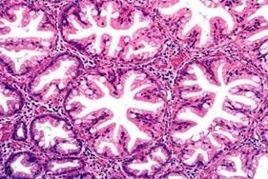
HPERPLASTIC POLYP
Notes:
NOTE the various types of epithelial cells….this is the reason it is benign, i.e., NON monoclonal.
The key word here is “SERRATED”

Slide 7
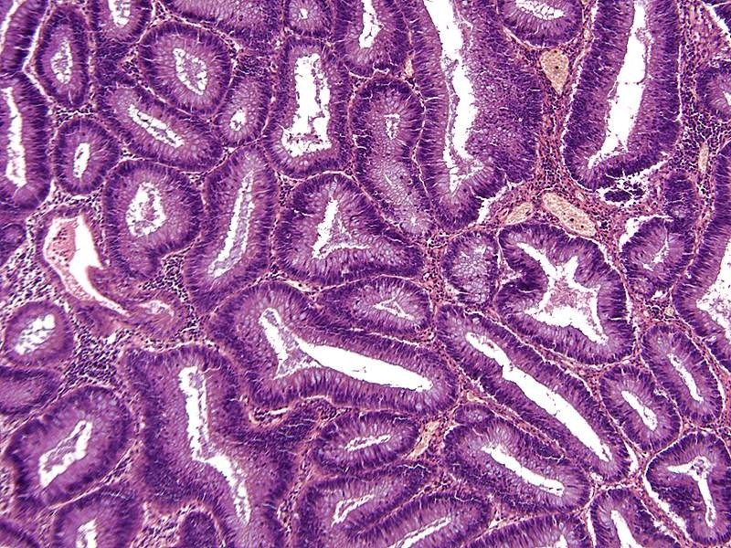
ADENOMATOUS POLYP (TUBULAR)
Notes:
TUBULAR adenoma, note how all the epithelial (glandular) cells look the same.

Slide 8
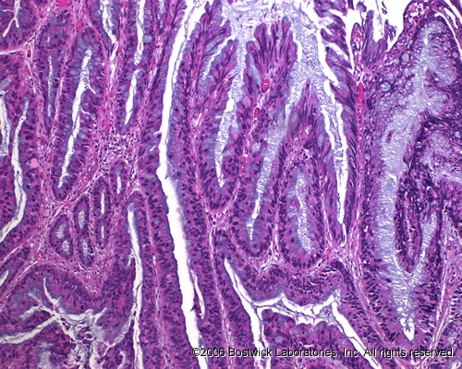
ADENOMATOUS POLYP (VILLOUS)
Notes:
Villous adenomas behave more aggressively than tubular adenomas. They have a HIGHER rate of developing into frank adenocarcinomas than the “tubular” patterns.
For geometric reasons alone, the VILLOUS pattern of growth is faster than the TUBULAR pattern!

Slide 9
“FAMILIAL” NEOPLASMS
1) POLYPOSIS (NON-NEOPLASTIC, hamartomatous)
2) POLYPOSIS (NEOPLASTIC, i.e., cancer risk)
3) HNPCC: (Hereditary Non Polyposis Colorectal Cancer)
Notes:
THREE types of hereditary or “familial” intestinal glandular tumors.

Slide 10
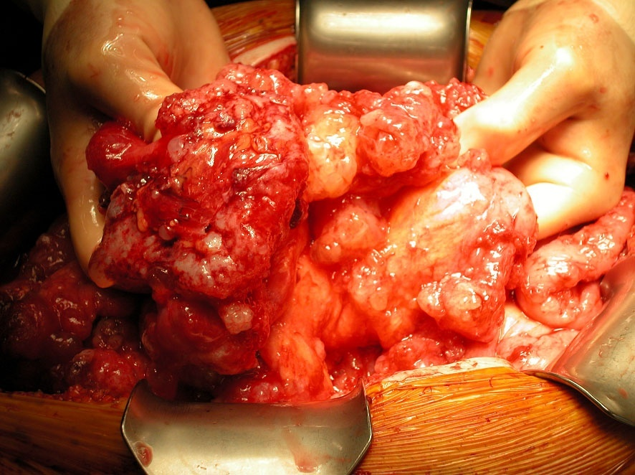

Slide 11
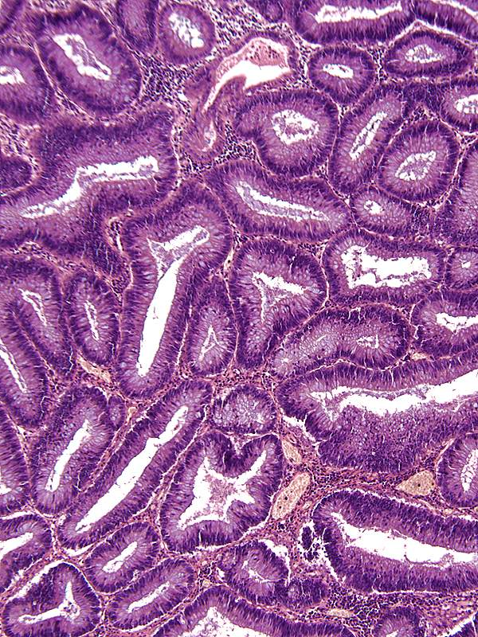
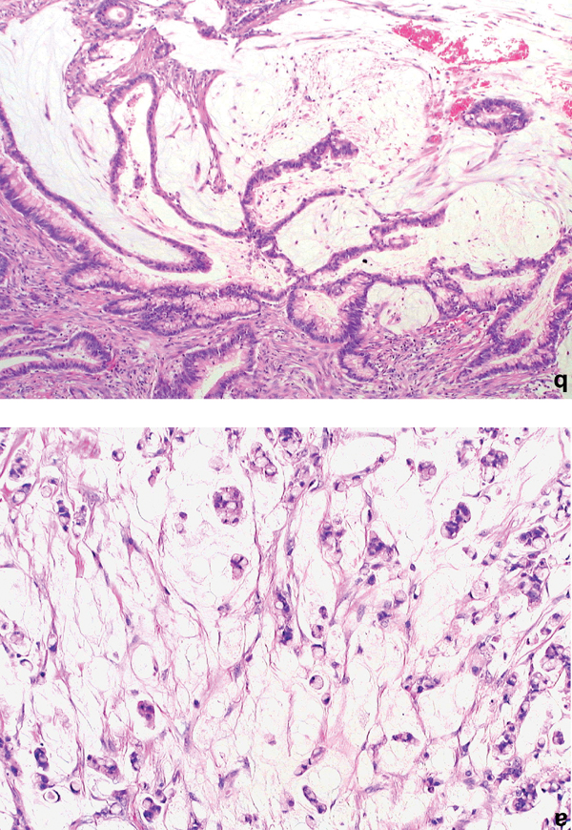
MUCINOUS CYSTADENO(CARCINO)MA
ADENOMA
CARCINOMA
Notes:
A RUPTURED MUCINOUS CYSTADENOCARCINOMA can look exactly like benign pseudomyxoma peritoneii, but with (malignant) tumor cells present. Most adenomas/adenocarcnomas of the appendix are VERY mucinous!

Slide 12
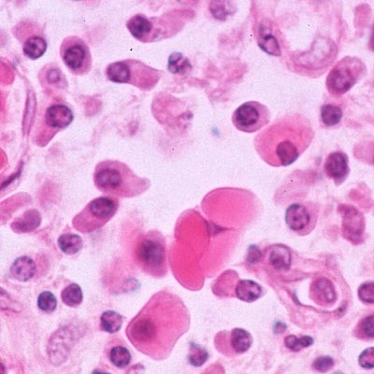
PERITONEUM
Visceral, Parietal: all lined by mesothelium
Peritonitis, acute:
  Appendicitis, local or with rupture
  Peptic ulcer, local or ruptured
  Cholecystitis, local or ruptured
  Diverticulitis, local or with rupture
  Salpingitis→ gonococcal or chlamydial, retrograde or perforated
  Ruptured bowel due to any reason
  Perforating abdominal wall injuries
Notes:
You MUST think of the peritoneum ANATOMICALLY to understand its pathology, unless you have a photographic memory for power point bullets!

Slide 13
PERITONITIS
E. coli
STREP
S. aureus
ENTEROCOCCUS

Slide 14
PERITONITIS, outcomes:
Complete RESOLUTION
Walled off ABSCESS
ADHESIONS

Slide 15
SCLEROSING RETROPERITONITIS
Unknown cause (autoimmune?)
Generalized retroperitoneal fibrosis, progressive→ hydronephrosis

Slide 16
TUMORS
MESOTHELIOMAS (solitary nodules or diffuse constricting growth pattern, also asbestos caused)
METASTATIC, usually diffuse, often looking very much like pseudomyxoma peritoneii, but containing tumor cells, usually adenocarcinoma

