Slide 1

RAD 204 PATHOLOGY
LECTURE 5 SECOND HALF (CVS PATHO)
DR SHAI’
WEEK OF OCTOBER 20, 2013
COLLEGE OF MEDICAL SCIENCES/RADIOLOGICAL SCIENCES DEP’T

Slide 2
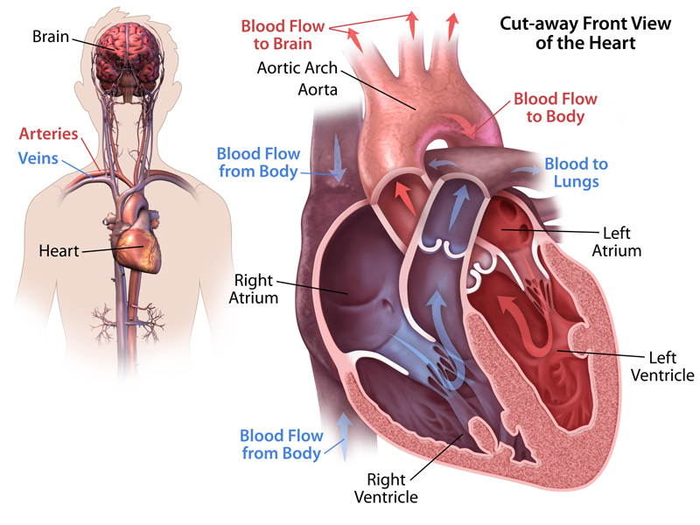
overview

Slide 3
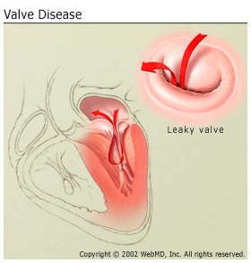
HEART VALVE DISEASE
VALVE DISORDERS:
  A) stenosis: narrowing / rigidity of valve
  B) regurgitation / incompetence: failure of valve to close fully
Factors contributing to heart valve damage:
  Congenital
  Post inflammatory scarring
  Degeneration with age
  Dilatation of valve ring
  Degeneration of collagen tissue support
  Necrotizing inflammation> acute cell death

Slide 4
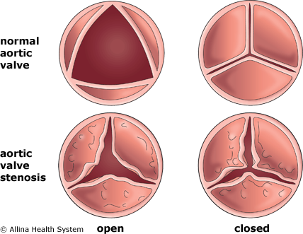
The mitral and aortic valves are most commonly affected

Slide 5
Degenerative valve disease
Calcific aortic stenosis
  1) degenerative CAVS: calcification of aortic valve a/w increasing age
  2) bicuspid CAVS: 40 – 50 yrs age
  In both types: valves thicken with fibrosis, large masses of calcium may be found subendothelially
  Effects: 1) aortic stenosis > decreased valve lumen reduced systolic flow
  2) aortic regurgitation> increase valve rigidity > no close valves > backflow into the LV during diastole
  Stenosis & regurgitation BOTH result in LVH (Left ventricular hypertrophy), coronary insufficiency, syncope, sudden death

Slide 6
Myxomatous degeneration of mitral valve (FLOPPY VALVE)
IDIOPATHIC PROLAPSE OF MITRAL VALVE LEAFLETS: leaflets are thickened, with abnormal collagen and excess deposits of mucopolysaccharides
Net result: mild valve incompetence, risk of rupture of chordae> valve incompetence

Slide 7
Rheumatic heart disease
Rheumatic fever: immune disorder that follows 2 – 3 weeks after stretococcal infection, usually tonsilitis or pharyngitis
Epidemiology: children 5 – 15 yo, Africa, Middle east, India, associated with poor nutrition & overcrowding
Pathogenesis: susceptible individuals develop antibodies to antigens produced by strains of streptococci, Abs cross react with HOST Ag

Slide 8
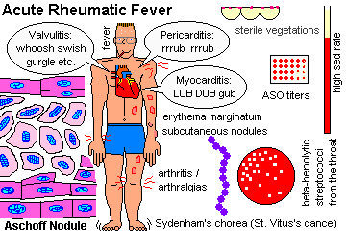
Heart: pericarditis, myocarditis, endocarditis (PANCARDITIS)
Joints: polyarthritis
Skin: subcutaneous nodules & erythema marginatum
Arteries: arteritis
Most important * HEART: repeated attacks lead to progressive fibrosis of endocardium & valves :
Chronic scarring of valves

Slide 9
Acute phase RH disease
Pericarditis: acute inflammation of pericardium
Myocarditis: mild inflammation with muscle fiber necrosis
Endocarditis: mitral valves most prone

Slide 10
Chronic phase RH disease
Scarring of valves
Pathogenesis: endocardial valve damage from acute phase heals by progressive fibrosis
Valve leaflets thicken, become fibrotic, shrunk, and fuse with other leaflets, and 2nd ary calcium deposits
After damage> altered haemodynamic stress continues EVEN IN THE ABSENCE of continued auto immune processes

Slide 11
Infective endocarditis
Acute disease resulting from infection of a focal area of endocardium
Any age, common in elderly and in males
Predisposing factors: Genitourinary infection, diabetes, tooth extraction, pressure sores, surgery
*PATIENTS WITH VALVE DISEASE ARE AT RISK OF IE , EVEN IN MINOR DENTAL PROCEDURES OR MINOR SURGERIES, SO PROPHYLACTIC ANTIBIOTICS ARE NEEDED TO PREVENT BACTERAEMIA

Slide 12
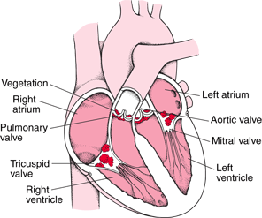

Slide 13
Infective endocarditis morphology
Characteristic lesions “ VEGETATIONS” from deposits of platelets, fibrin, bacteria.
Vegetations form in HIGH pressure areas, eg incompetent valve
Almost all vegetations occur on valve leaflets or occlusion masses.
Mitral and aortic valves are mostly affected

Slide 14
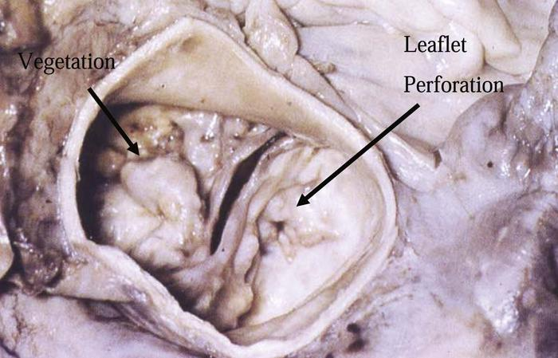

Slide 15
Causative organisms IE
Pathogens: staphylococcus aureus, B- haemolytic streptocicci, pneumococci,meningococci, E. coli
Low grade pathogens: streptococcus viridans, s. faecalis, staph, epidermidis, haemophilus, brucella, mycobacteria, g- negative organisms
Fungi: candida, aspergillus, etc.

Slide 16
Types of IE
Acute
  By virulent organism, eg staph aureus, affects normal and abnormal valves
  Destruction of valve leaflets, perforation of valve > acute heart failure
  Prognosis: rapidly destructive and fatal
Sub Acute
  Poorly virulent organisms, streptococcus viridans, affects abnormal valves
  Bacteria proliferate slowly in thrombotic vegetation on damaged valve surface: stimulates further thrombus formation: systemic emboli

Slide 17
Clinical manifestations of IE
SYSTEMIC: fever, weight loss, malaise die to cytokine generation
Skin petechiae: microhaemorrhages in retina & skin, esp fingernails (splinter haemorrhages from AB-AG complex deposition)
Clubbing of fingers
Splenomgealy and anaemia

Slide 18
Marantic endocarditis
Non bacterial thrombotic endocarditis, is inflammation of valves with formation of sterile thrombotic vegetations (marantic vegetations)
On the closure lines of valve cusps
Occurs in debilitated patients with systemic disease

Slide 19
LIBMAN SACKS (SLE) ENDOCARDITIS
Thrombotic vegetations in systemic lupus erythematosus (SLE)
IN 50% OF FATAL SLE
Thrombotic material can fragment and cause embolic infarction

Slide 20
Diseases of the myocardium
CARDIOMYOPATHY:
  Group of disorders of myocardium
  Cause progressive cardiac failure
  MYOCARDITIS IS INFLAMMATION OF MYOCARDIUM, it is a form of 2nd ary cardiomyopathy
  Primary: idiopathic
  Secondary : heart muscle disease

Slide 21
primary
1) congestive: from poor systolic contraction
  Dilatation of ventricles
  Thin, stretched chamber walls
  Hypocontractile muscle
2) hypertrophic cardiomyopathy: familial, hyperkinetic systolic funtionc and reduction in systolic volume, and difficulty in diastolic filling
  Gross hypertrophy of heart wall
  Loss of normal muscle fibres – disorganized branching
  Young adults with suddent death on exertion (HOCM)
3) Restrictive cardiomyopathy: abnormal stiffness of myocardium, impaired ventricle filling
  From amyloids in amyloidosis
  Haemochromatosis
  Endomyocardial fibrosis

Slide 22
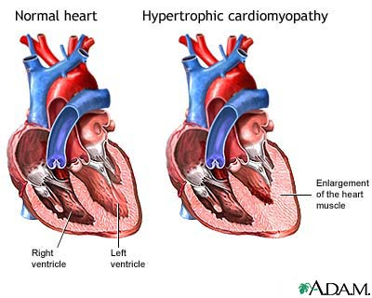

Slide 23
secondary
1) myocarditis
  aetiology infectious or immune related
    Viruses, bacteria, fungi, protozoa, helminths
    Pos streptococcal rh fever, SLE, post viral, drug hypersensitivity, transplant rejection, sarcoidosis

Slide 24
Neoplasms of heart
Rare
Myxoma: benign tumour of stellate cells in endocardium
Lipoma connective tissue neoplams
Malignant rhabdomyosarcomas
Metastases

Slide 25
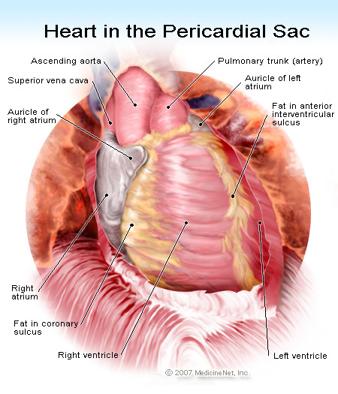

Slide 26
Disease of pericardium
PERICARDIAL EFFUSION
  Accumulation of fluid within pericardial cavity
  Serous effusion: transudate with low protein (<2 g /100mL) with scanty mesothelial cells, from heart failure, hypoalbuninaemia, myxoedema
  Serosanguinous: exudate with HIGH protein (>3 g /100 mL), with infection, uraemia, neoplasia, connective tissue disorders
  Chyous: accumulation of lymphatic fluid in lymph obstruction pf pericardial drainage, in neoplasm and tuberculosis
  Aetiology: 1) inflammatory (acute pericarditis), non inflammatory

Slide 27
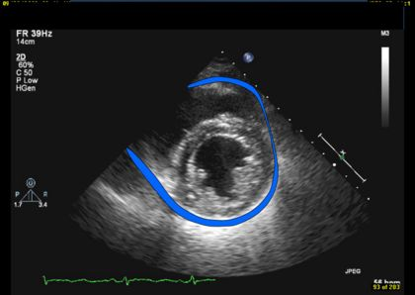
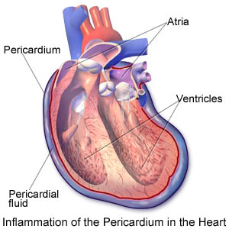
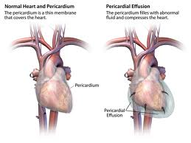

Slide 28
Non inflammatory:
  High capillary permeability (severe hypothyroidism), high capillary hydrostatic pressure (congestive heart failure), low plasma oncotic pressuRe (cirrhosis, nephrotic syndrome)
  Pathophysiology: large amounts of fluid will interfere with heart’s action
  Increase in pressure in pericardium further effusions

Slide 29
Cardiac tamponade
Fluid, of any kind, accumulates under high pressure compressing cardiac chambers so much that filling of the heart is severely limited
DIAGNOSIS:
Signs: tachycardia, increased jugular venous pulse (on inspiration JVP), DECREASED SYSTEMIC BLOOD PRESSURE
May be fatal

Slide 30
PERICARDITIS
INFLAMMATION OF PERICARDIUM, complicated by effusion development
ACUTE PERICARDITIS
  Both visceral & parietal layers are coated with rich-fibrin, acute inflammatory exudate, loss of smoothness leads to FRICTION RUB
  Aetiology
    Infarction, infective, injury , invasive/malignant, immunological
CHRONIC PERICARDITIS
Progressive fibrinous adhesions, calcification of pericaridum, restriction in ventricular filling, interferes with systole
Post tuberculous pericarditis, viral pericarditis, rheumatoid arthritis,

Slide 31
ANEURYSMS
Abnormal, localized, permanent dilatation of an artery
1) TRUE ANEURYSMS: wall is formed by 1 or more layers of affected vessels
2) FALSE ANEURYSMS: wall formed by connective tissue, NOT PART OF VESSEL, FROM trauma or infection
TRUE MORPHOLOGY: saccular aneurysms are globular sacs, and fusiform aneurysms are spindle shaped due to long segments of vessel wall being affected

Slide 32
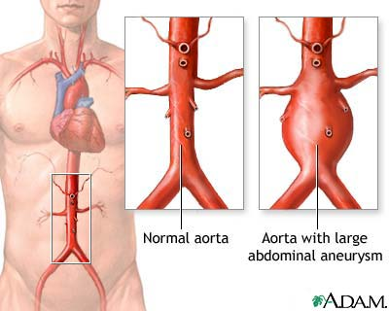

Slide 33
AETIOLOGY & PATHOGENESIS
ANY abnormality that weakens the media
Atherosclerosis: commonest cause, esp abdominal aorta
Cystic Medial Degeneration: focal degeneration of media with formation of small cyst spaces
Occur because of weakening in arterial wall, with loss of elasticity and contractibility
Stretching of weakened wall is progressive due to haemodynamic pressure forces, producing increased thinning of the wall
Eventually RUPTURE occurs

Slide 34
ABDOMINAL AORTIC ANEURYSMS
Common in men, over 60 yo
Aetiology: atherosclerosis is commonest cause
Others: vasculitic inflammation, mycotic infection
Site: usually below the renal arteries, and so are amenable to resection & graft replacement
Morphology: atherosclerotic aneurysms produce fusiform dilatations of wall
Signs & symptoms: asymptomatic, pulsing severe

Slide 35
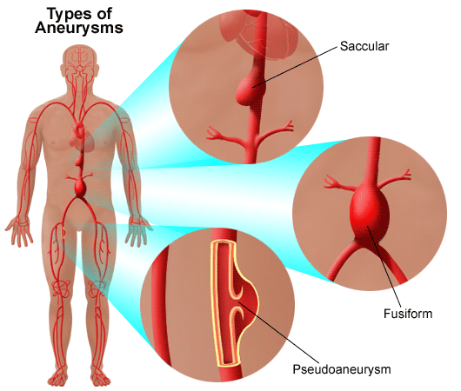

Slide 36
radiology
Most diagnoses made on radiographs, aortic dilatation visible
Especially if walls of aneurysms are calcified
May cause back pain and symptoms of compression of neighbouring structures
Confirmation of AAA: achieve by ultrasonagraphy, CT, MRI or arteriography

Slide 37
Aortic Dissection
Tear in the intima of aorta followed by entry of blood into media with separation of FLAP of intima from the rest of the aortic wall.
A false lumen is created, usually between inner 2/3 and outer 1/3 of medial thickness
Gives the appearance of a double barreled aorta
TYPE A: 67%, in ascendign aorta, + or – extention into decending aorta
TYPE B: 33% , confined to descending aorta, distal to origin of left subclavian artery
Usually result of cystic medial degeneration (risk factors)
  HYPERTENSION, MARFAN’S PREGNANCY, CONGENITAL

Slide 38
CONSEQUENCES
EXTERNAL RUPTURE: massive fatal bleed into thoracic cavity
INTERNAL RUPTURE: rare
Clinical features
  Severe pain: sudden onset, chest & back, between shoulder blades
  HYPERTENSION
  Assymetry of brachial, carotid, femoral pulses
  Broadenind aortic ‘KNUCKLE’ ON Chest radiograph
  Left sided pleural effusion

Slide 39
diagnosis
  Made by CT or angiography
  TYPE A: emergency surgical repair under cardio pulmonary bypass
  TYPE B: control of hypertension with bed rest
  Fatal without treatment

Slide 40
Diagnostic angiography
ARTERIOGRAPHY:
Arteriograms are performed via catheter, introduced into blood vessel
Contrast injected through catheter which opacifies the target vessel
Images are obtained by digitally subtracting the background image prior to injection
Indications:
  Diagnosis of vascular dz (venous occlusive dissease, aneurysm, AV fistula)
  Diagnosis of vascular tumors
  Pre operative identification of vascualr anatomy
  Performance of vascular interventional procedures

Slide 41
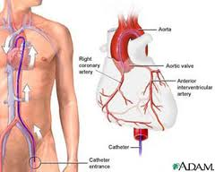
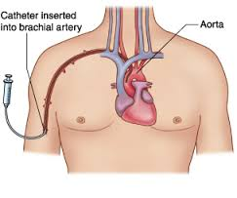
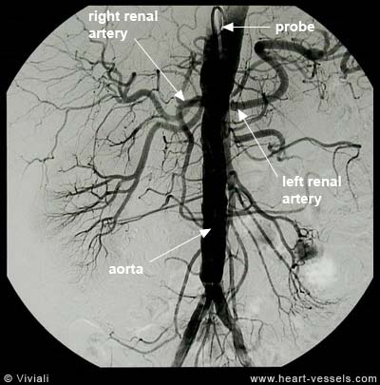

Slide 42
Magnetic resonance angiography
Non invasive
Shows arteries & veins
Contrast agent (gadolinium DTPA) into peripheral vein
Useful for visualizing the aorta & it’s branches
Aortic dissection
Portal vein
Peripheral vascular disease
Aneurysms & vascular malformation can be detected in intra cranial circulation

Slide 43
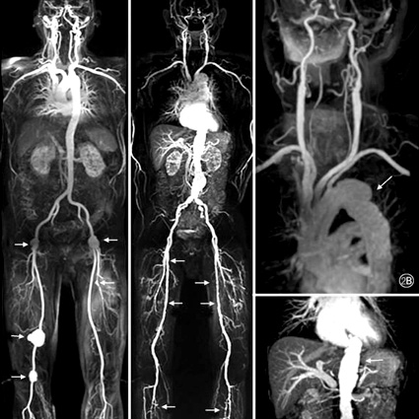
MRA

Slide 44
CT Angiography
Enables large parts of the body to be scanned quickly
IV contrast, see multiple sections in planes
Aorta, branches, aneurysms, leakages

Slide 45
Ultrasound of arterial system
Esp in carotid arteries & peripheral vessels
Carotid neck arteries see plaques, luminal narrowing

Slide 46
HOMEWORK
STUDY FOR THE EXAM
MAKE A STUDY SHEET ON THE TYPES OF INTERVENTIONAL RADIOLOGY USED IN CARDIOVASCULAR PATHOLOGY

