Slide 2
OESOPHAGITIS
CHEMICAL
  LYE (suicide attempts) with strictures
  Alcohol
  Extremely HOT drinks
  CHEMO (often harmful to ALL high turnover mucosas)
INFECTIOUS
  HSV, CMV, Fungal (especially CANDIDA)‏

Slide 3
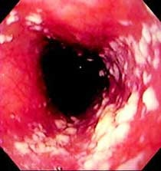
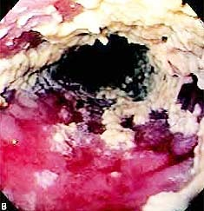
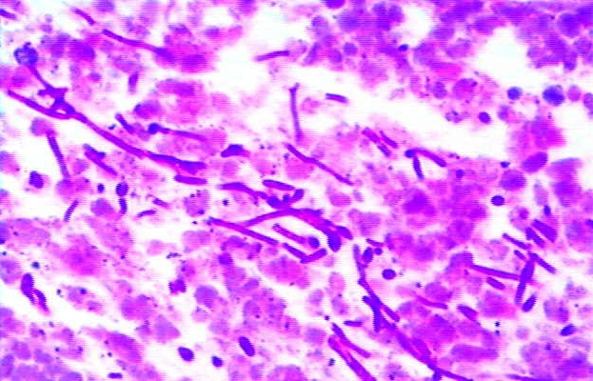
OESOPHAGITIS
Notes:
Candida, candida esophagitis in a HIV positive patient often is indicative of “full blown” AIDS.
3

Slide 4
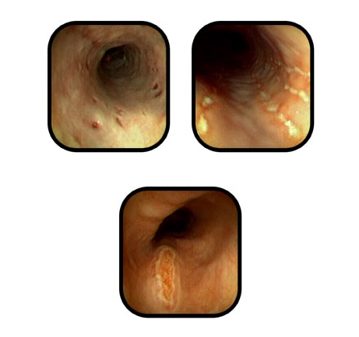
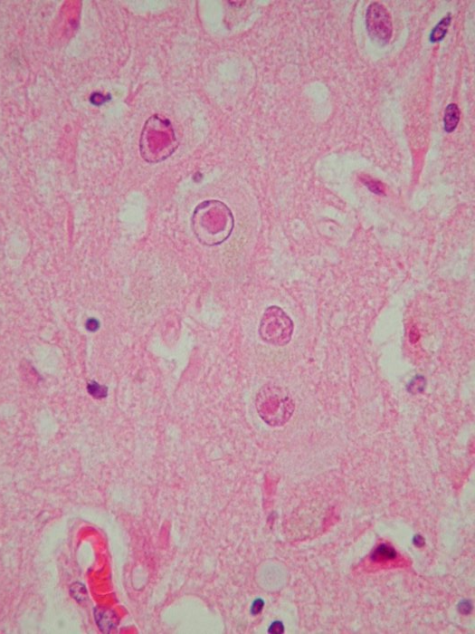
OESOPHAGITIS
Notes:
Herpes, from the points of view of the endoscopist and the pathologist. Might these large nucleolated cells be exfoliated as “Tzanck” cells? Answer: YES
4

Slide 5
TUMORS
BENIGN
MALIGNANT
  Squamous cell carcinoma
  Adenocarcinoma

Slide 6
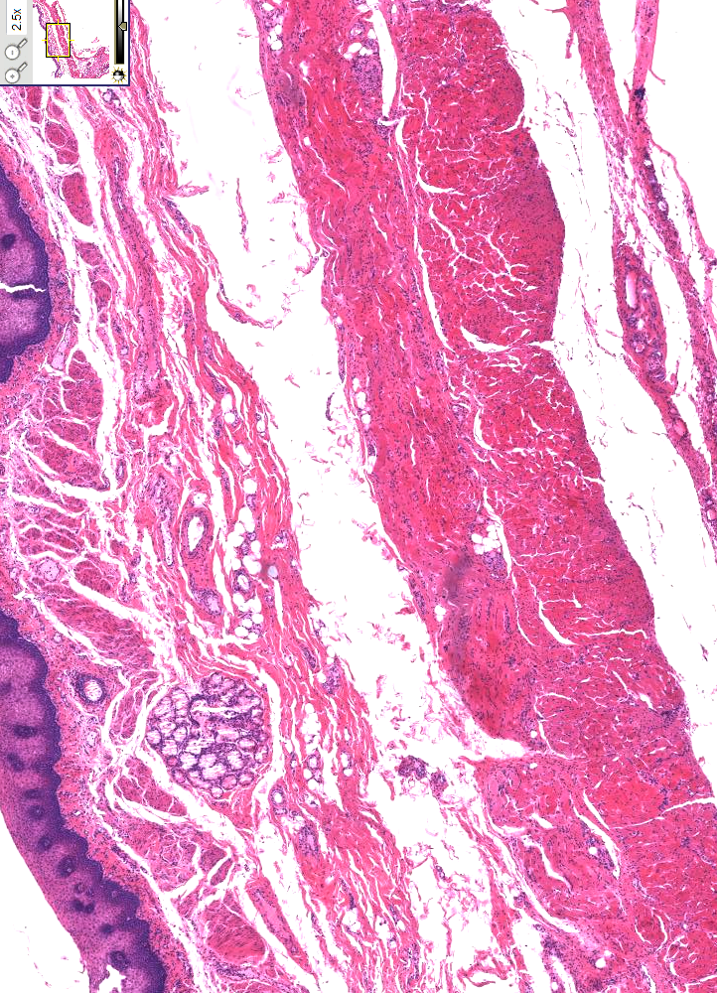
BENIGN TUMORS
LEIOMYOMAS
FIBROVASCULAR POLYPS
CONDYLOMAS (HPV)‏
LIPOMAS
“GRANULATION” TISSUE (PSEUDOTUMOR)‏
Notes:
The very BEST way to classify ALL tumors of a major organ is to remember its basic HISTOLOGY.
You do NOT need to memorize a stupid list from a pathology lecture, just remember an organ’s native cells!
6

Slide 7
SQUAMOUS CARCINOMA
Nitrites/Nitrosamines
Betel
Fungi in food (nitrosamines)
Tobacco
Alcohol
oesophagitis?

Slide 8
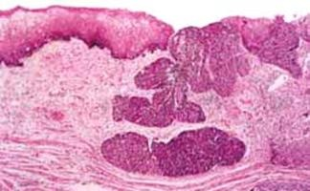
SQUAMOUS CARCINOMA
DYSPLASIA→IN-SITU→INFILTRATION

Slide 9
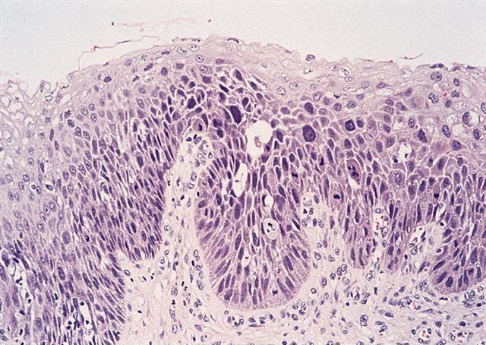
Notes:
Would you call this squamous “dysplasia”? Answer: YES
Would your fear it would develop into squamous cell carcinoma? Answer: YES
Does it always? Answer: NO
Does it usually? Answer: With time, YES, but that time may be years and years.

Slide 10
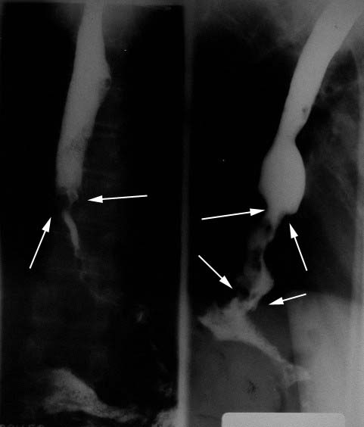
Notes:
Why is a cancer in the LOWER part of an esophagus MUCH less likely to be SQUAMOUS, than in the UPPER part? Answer: Barretts.

Slide 11
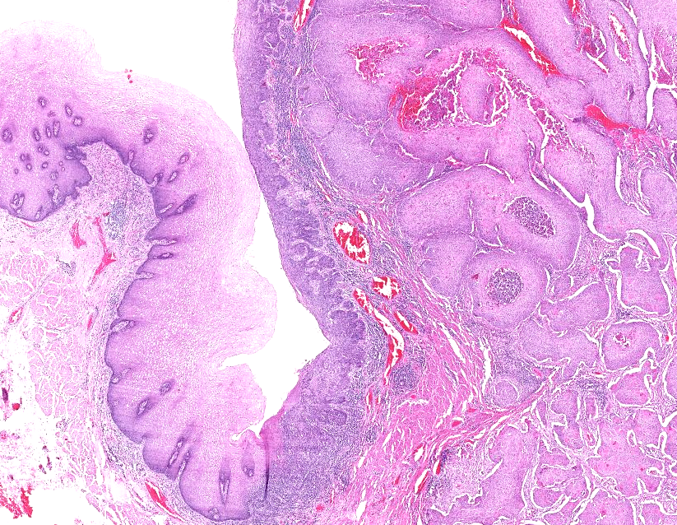

Slide 12
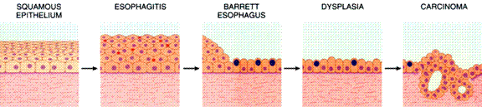
ADENOCARCINOMA
Notes:
The transition of a normally squamous esophageal mucosa to a glandular or “intestinal” type of a mucosa is called BARRETTS.

Slide 13
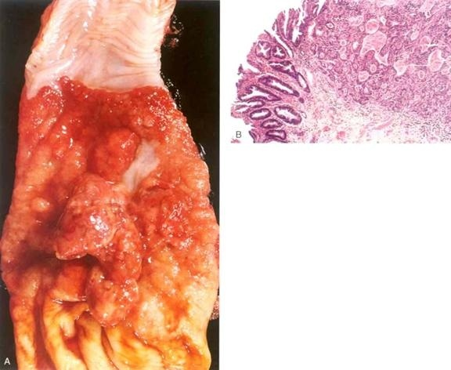

Slide 14
STOMACH OVERVIEW
NORMAL: Anat., Histo, Physio.
PATHOLOGY
CONGENITAL
GASTRITIS
PEPTIC ULCER
“HYPERTROPHIC” GASTRITIS
VARICES
TUMORS
BENIGN
ADENOCARCINOMA
OTHERS
Notes:
Moving down the GI tract, next stop: Stomach!

Slide 15
ANATOMY
Cardia (esoph), Fundus (diaph), Body (acid), Antrum, Pylorus
Greater/Lesser Curvatures
1500-3000 ml
Rugae
INNERVATION: VAGUS, Sympathetic
VEINS: Portal
Blood Supply: RG, LG, RGE(O), LGE(O), SG, ALL 3 branches of the celiac, no matter what the variations may be.

