Slide 1
Lecture 8.3 rad240 pathology
Gastrointestinal pathology
Dr shai’

Slide 2
GASTRITIS
ACUTE
CHRONIC
AUTOIMMUNE
OTHER
  EOSINOPHILIC
  ALLERGIC
  LYMPHOCYTIC
  GRANULOMATOUS
  GVH
Notes:
The acute/chronic patterns of gastritis generally conform to the poly/mono principles we so often have referred to. The “other” category of gastritis are also histologically based.

Slide 3
GASTRITIS
ACUTE, HEMORRHAGIC
(NSAIDs), particularly aspirin
Excessive alcohol consumption
Heavy smoking
CHEMO
Uremia
Salmonella, CMV
Severe stress (e.g., trauma, burns, surgery)
Ischemia and shock
Suicidal attempts, as with acids and alkali
Gastric irradiation or freezing
Mechanical (e.g., nasogastric intubation)
Distal gastrectomy
Notes:
The concepts and histologic changes in acute and chronic follow of course the classic histologic principles:
Acute→ polys
Chronic→ monos
However, the main CLINICAL differentiation between acute and chronic gastritis would be the presence or absence of blood, respectively.

Slide 4
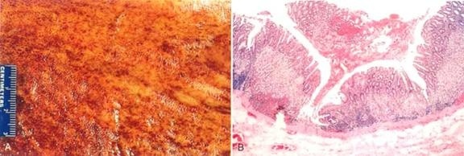
GASTRITIS
ACUTE, HEMORRHAGIC
HISTOLOGY: Erosion, Haemorrage, NEUTROPHILS
Notes:
The concepts and histologic changes in acute and chronic follow the classic histologic principles:
Acute→ polys
Chronic→ monos

Slide 5
GASTRITIS
CHRONIC, NO EROSIONS, NO HEMORRHAGE
Chronic infection by H. pylori
Immunologic (autoimmune), e.g., PA
Toxic, as with alcohol and cigarette smoking
Postsurgical, reflux of bile
Motor and mechanical, including obstruction, bezoars (luminal concretions), and gastric atony
Radiation
Granulomatous conditions (e.g., Crohn disease)
GVH, uremia
Notes:
ACUTE gastritis→ Hemorrhage, “erosions”, neutrophils (i.e., “POLYS”)
CHRONIC gastritis→ MONOS, NO hemorrhage, NO erosions
And do not forget: CHRONIC of the follows ACUTE

Slide 6
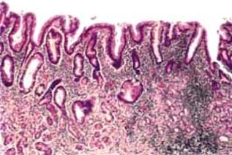
GASTRITIS
CHRONIC, NO EROSIONS, NO HEMORRHAGE
Perhaps some neutrophils
Lymphocytes, lymphoid follicles
REGENERATIVE CHANGES
  METAPLASIA, intestinal
  ATROPHY, mucosal hypoplasia, “thinning”
  DYS-PLASIA

Slide 7
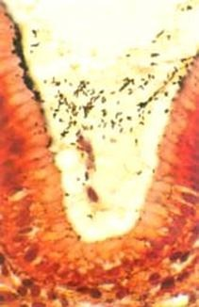
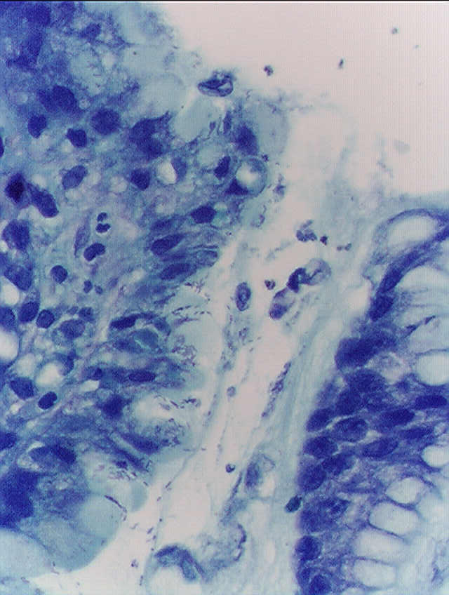
Notes:
Helicobacter pylori, gastric biopsy, silver stain on left, Giemsa stain on right. As a rule, these bugs ADHERE closely to the gastric mucin rather than invade the epithelial cells.

Slide 8
GASTRITIS
AUTOIMMUNE (10%)
ANTIBODIES AGAINST→
  acid producing enzyme H⁺
  K⁺ -ATPase
  gastrin receptor
  and intrinsic factor
OTHER
  EOSINOPHILIC, middle aged women
  ALLERGIC, children (also eosinophils)
  LYMPHOCYTIC, T-Cells, body, DIFFUSE
  GRANULOMATOUS, Crohn’s, other granulomas
  GVH, in bone marrow transplants
Notes:
Would an autoimmune gastritis be associated with megaloblastic anemia? Why? Answer: DECREASED intrinsic factor
No doubt achlorhydria is the common factor of chronic gastritis and B12 megaloblastic anemias

Slide 9
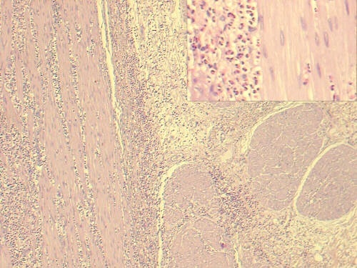
Notes:
Eosinophilic gastritis.
If these were granulomas rather than eosinophils, what kind of gastritis would it be? (rhetorical question)

Slide 10
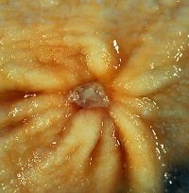
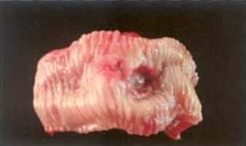
“PEPTIC” ULCERS
“PEPTIC” implies acid cause/aggravation
ULCER vs. EROSION (muscularis mucosa intact)
MUC→SUBMUC→MUSCULARIS→SEROSA
Chronic, solitary (usually), adults
80% caused by H. pylori
100% caused by H. pylori in
duodenum
NSAIDS
“STRESS”

Slide 11
Helicobacter pylori
Causes 80% of gastric peptic ulcers
Causes 100% of duodenal peptic ulcers
Causes chronic gastritis
Causes gastric carcinomas
Causes MALT lymphomas

Slide 12
“PEPTIC” ULCERS
Gnawing, burning, aching pain, epigastric
Fe deficiency anemia
Acute hemorrhage
Penetration, perforation:
  Pain in BACK
  Pain in CHEST
  Pain in LUQ
NOT felt to develop into malignancy

Slide 13
“PEPTIC” ULCERS
Bleeding
  Occurs in 15% to 20% of patients
  Most frequent complication
  May be life-threatening
  Accounts for 25% of ulcer deaths
  May be the first indication of an ulcer
Perforation
  Occurs in about 5% of patients
  Accounts for two thirds of ulcer deaths
  Rarely, is the first indication of an ulcer
Obstruction from edema or scarring
  Occurs in about 2% of patients
  Most often due to pyloric channel ulcers
  May also occur with duodenal ulcers
  Causes incapacitating, crampy abdominal pain
  Rarely, may lead to total obstruction with intractable vomiting
Notes:
Would this slide be seen in a REAL classroom to those sitting in the back row?

Slide 14
“ACUTE” ULCERS
NSAIDS
“STRESS” ULCERS
  ENDOGENOUS STEROIDS
    SHOCK
    BURNS
    MASSIVE TRAUMA
    Intracranial trauma, Intracranial surgery
    SEPSIS
  EXOGENOUS STEROIDS
    CUSHING ULCER
Notes:
Please remember acute “stress” ulcers are highly related to an EXCESS of endogenous or exogenous steroids.
Not surprisingly, acute “ulcers” are likened to acute “gastritis”. Does this list look familiar?

Slide 15
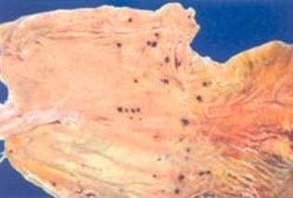
“ACUTE” ULCERS
Usually small (<1cm), superficial, MULTIPLE
Notes:
This type of acute “stress” ulcer is often confused with ulceration from gastric intubation, but intubation ulcers are usually more linear and less diffuse.
It is not at all unusual to see, at autopsy, stomachs that look like this in people whose death was preceded by extreme physiologic stress.

Slide 16
GASTRIC DILATATION
PYLORIC STENOSIS
PERITONITIS (→ pyloric stenosis)
1.5-3.0 liters NORMAL
10 liters can be present
ACUTE RUPTURE is associated with a HIGH immediate mortality rate

Slide 17
“HYPERTROPHIC”* GASTROPATHY
RUGAL PROMINENCE (cerebriform)
NO INFLAMMATION
HYPERPLASIA of MUCOSA
Notes:
*Probably better termed “hyperplastic” by the traditional classical definition, but, conventionally, called “hypertrophic”.

Slide 18
“HYPERTROPHIC” GASTROPATHY
Inaccurate name “hypertrophic gastritis”
• Ménétrier disease, resulting from profound hyperplasia of the surface mucous cells with accompanying glandular atrophy, ass. w. CMV, H. Pylori, ↑TGF-α
• Hypertrophic-hypersecretory gastropathy, associated with hyperplasia of the parietal and chief cells within gastric glands (normal gastrin)
• Gastric gland hyperplasia secondary to excessive gastrin secretion, in the setting of a gastrinoma (Zollinger-Ellison syndrome)
Notes:
Note that the “hypertrophy” is really various types of “hyperplasia”.

Slide 19
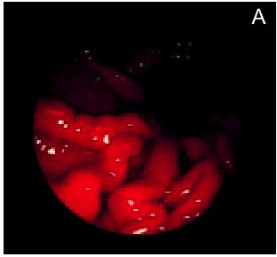
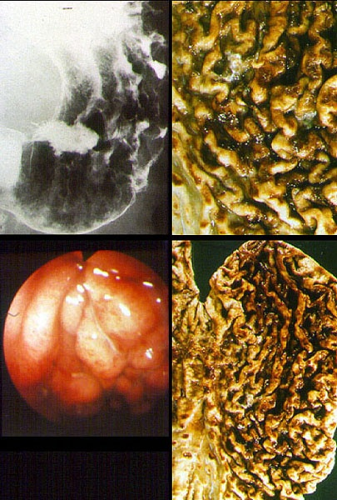
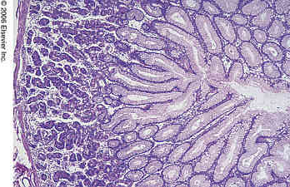
Notes:
Note prominence or “cerebrated” appearance of rugae.
Hyperplastic gastric mucosa necessitates an increase in surface area, i.e., rugal prominence.

Slide 20
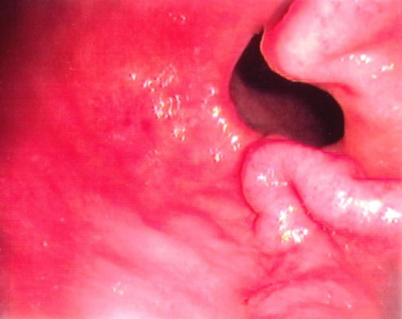
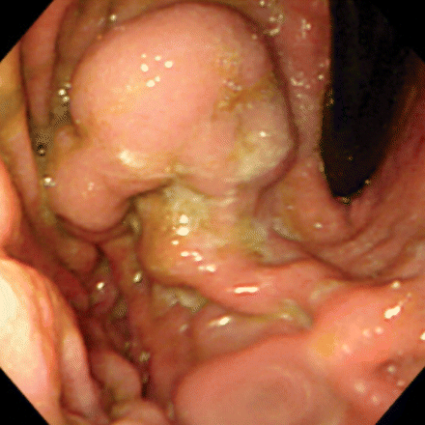
GASTRIC “VARICES”
SAME SETTING AND ETIOLOGY AS ESOPHAGEAL VARICES, i.e., PORTAL HYPERTENSION
NOT AS COMMON AS ESOPHAGEAL VARICES
MAY LOOK LIKE PROMINENT RUGAE
IF A PATIENT HAS GASTRIC VARICES, HE ALSO PROBABLY HAS ESOPHAGEAL, (but probably not vice versa)

Slide 21
GASTRIC TUMORS
BENIGN:
  “POLYPS*” (HYPERPLASTIC vs. ADENOMATOUS)
  LEIOMYOMAS (Same gross and micro as smooth muscle)
  LIPOMAS (Same gross and micro as adipose tissue)
MALIGNANT
  (ADENO)-Carcinoma
  LYMPHOMA
POTENTIALLY MALIGNANT
  G.I.S.T. (Gastro-Intestinal “Stromal” Tumor)
  CARCINOID (NEUROENDOCRINE)
Notes:
In general. A “polyp*” can be thought of as ANYTHING which projects as a bump or nodule from a mucosal surface.
HYPERPLASTIC POLYPS are considered to be NON-neoplastic, and therefore NEVER turn into cancers. ADENOMATOUS polyps are true benign neoplasms and MAY turn into carcinomas, particularly if the exhibit DYSPLASIA on biopsy.
This SAME general principle, is even MORE true of the colon!
But in general, you know the drill: 1) Benign, 2) Malignant, and 1) epithelial, 2) stromal, and 3) lymphoid

Slide 22
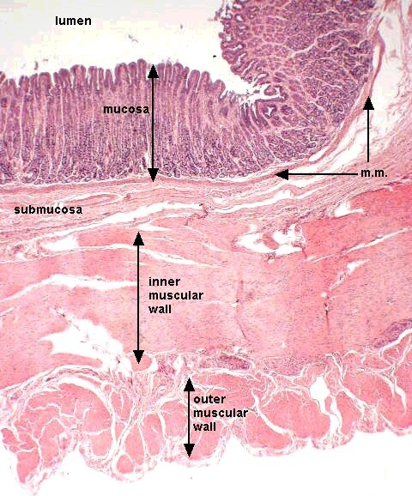
BENIGN TUMORS
MUCOSA
(POLYPS)
---HYPERPLASTIC
---Fundic
---Peutz-Jaeger
---Juvenile
---ADENOMATOUS
MUSCLE
FAT
BEBNIBGNB
Notes:
The concept of GASTRIC polyps generally follows the concepts of COLONIC polyps, i.e., HYPERPLASTIC are ALL benign with many different types of cells, and ADENOMATOUS are more “associated” with malignancy, but are NOT NECESSARILLY pre-malignant.

Slide 23
MALIG. TUMORS
MUCOSA
LYMPHS
(MUSCLE)
(FAT)
BEBNIBGNB

Slide 24
WHO GASTRIC NEOPLASMS
Epithelial Tumors: Adenomatous polyps, Adenocarcinoma (papillary, tubular, mucinous, signet ring, adenosquamous, unclassified), Small cell, Carcinoid (neuroendocrine)
Nonepithelial Tumors: Leiomyo(sarc)oma, Schwannoma, GIST, Granular Cell Tumor, Kaposi sarcoma
Malignant Lymphomas:

Slide 25
ADENOCARCINOMA
H. pylori associated, MASSIVELY!!!
Japan, Chile, Costa Rica, Colombia, China, Portugal, Russia, and Bulgaria
M>>F
Socioeconomically related*
Notes:
* WHY? ANS: Poorer people eat more nitrated preserved foods? Spicy foods? Less fresh foods?

Slide 26
SMALL/LARGE INTESTINE
NORMAL: Anat., Vasc., Mucosa, Endocr., Immune, Neuromuscular.
PATHOLOGY:
  CONGENITAL
  ENTEROCOLITIS: DIARRHEA, INFECTIOUS, OTHER
  MALABSORPTION: INTRALUMINAL, CELL SURFACE, INTRACELL.
  (I)IBD: CROHN DISEASE and ULCERATIVE COLITIS
  VASCULAR: ISCHEMIC, ANGIODYSPLASIA, HEMORRHAGIC
  DIVERTICULOSIS/-ITIS
  OBSTRUCTION: MECHANICAL, PARALYTIC (ILEUS) (PSEUDO)
  TUMORS: BENIGN, MALIGNANT, EPITHELIAL, STROMAL
Notes:
Most of the pathology concepts are logical and easy. A couple are a little involved.

Slide 27
ANATOMY
SI = 6 meters (100% intraP, except for duodenum), LI = 1.5 meters (50% retroP)
Mucosa, submucosa, muscularis, serosa/adv.
2πr x L = ?
Notes:
How does about 5 square feet turn into a tennis court?

Slide 28
BLOOD SUPPLY
SI: SMA→ Jejunal, Ileal
LI: SMA, IMA→ Ileocolic, R, M, L, colic, Sup. Rect
RECTUM: Superior, Middle, Inferior
SMA has anastomoses with CELIAC (pancreatoduodenal), IMA (marginal)
Notes:
Why is the middle and inferior rectal artery so different from the superior? ANS: They do NOT come from the IMA

Slide 29
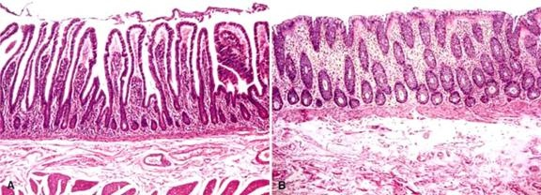
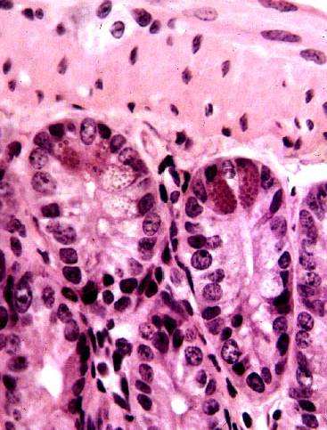
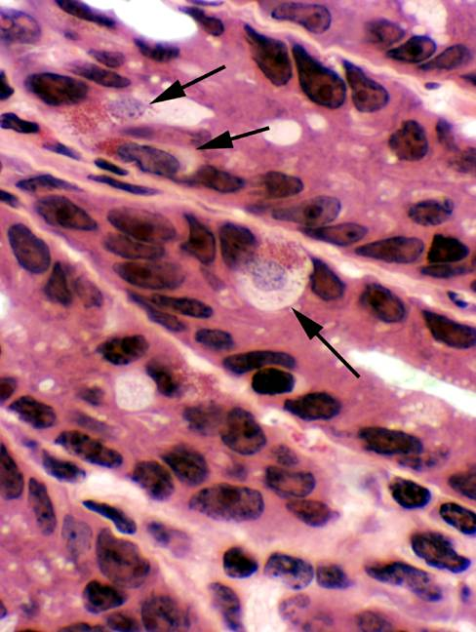
MUCOSA
SI: ABSORPTIVE, MUCUS, PANETH (apical granules)
  VILLI
LI: MUCUS, ABSORPTIVE, ENTEROENDOCRINE (basal granules)
  CRYPTS (like stomach), NOT villi
Notes:
The SI has a “villous” or “papillary”, i.e., hairy surface appearance, while the LI has a configuration similar to the stomach, i.e., “pits and glands”

Slide 30
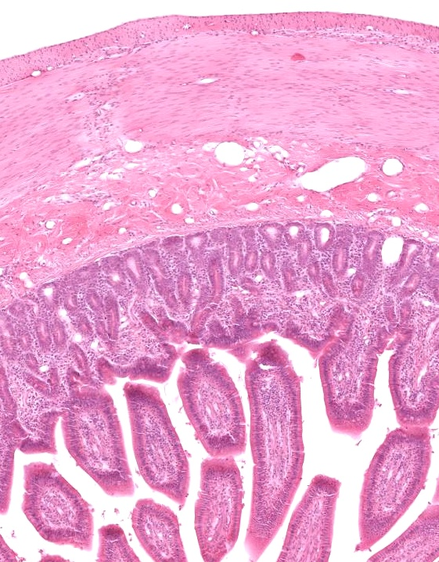
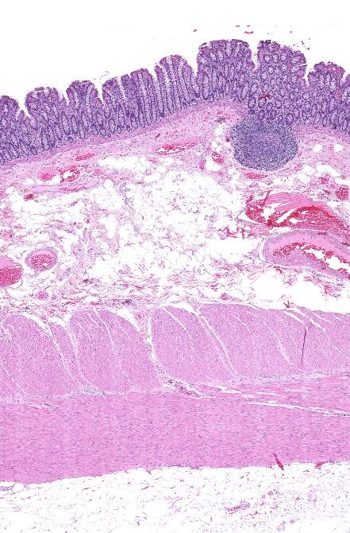
Notes:
MALT lymphoid tissue (redundant) is rich in th lamina propria of the mucosa and extends throughout the submucosa too. Why? Answer: To secrete IgA and other antibodies against potential pathogens.

